Slide 1
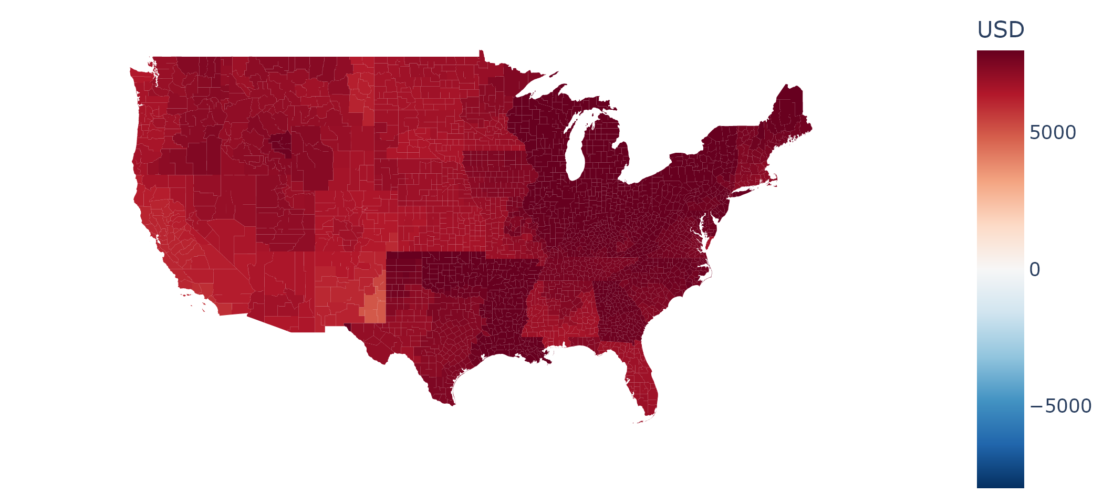
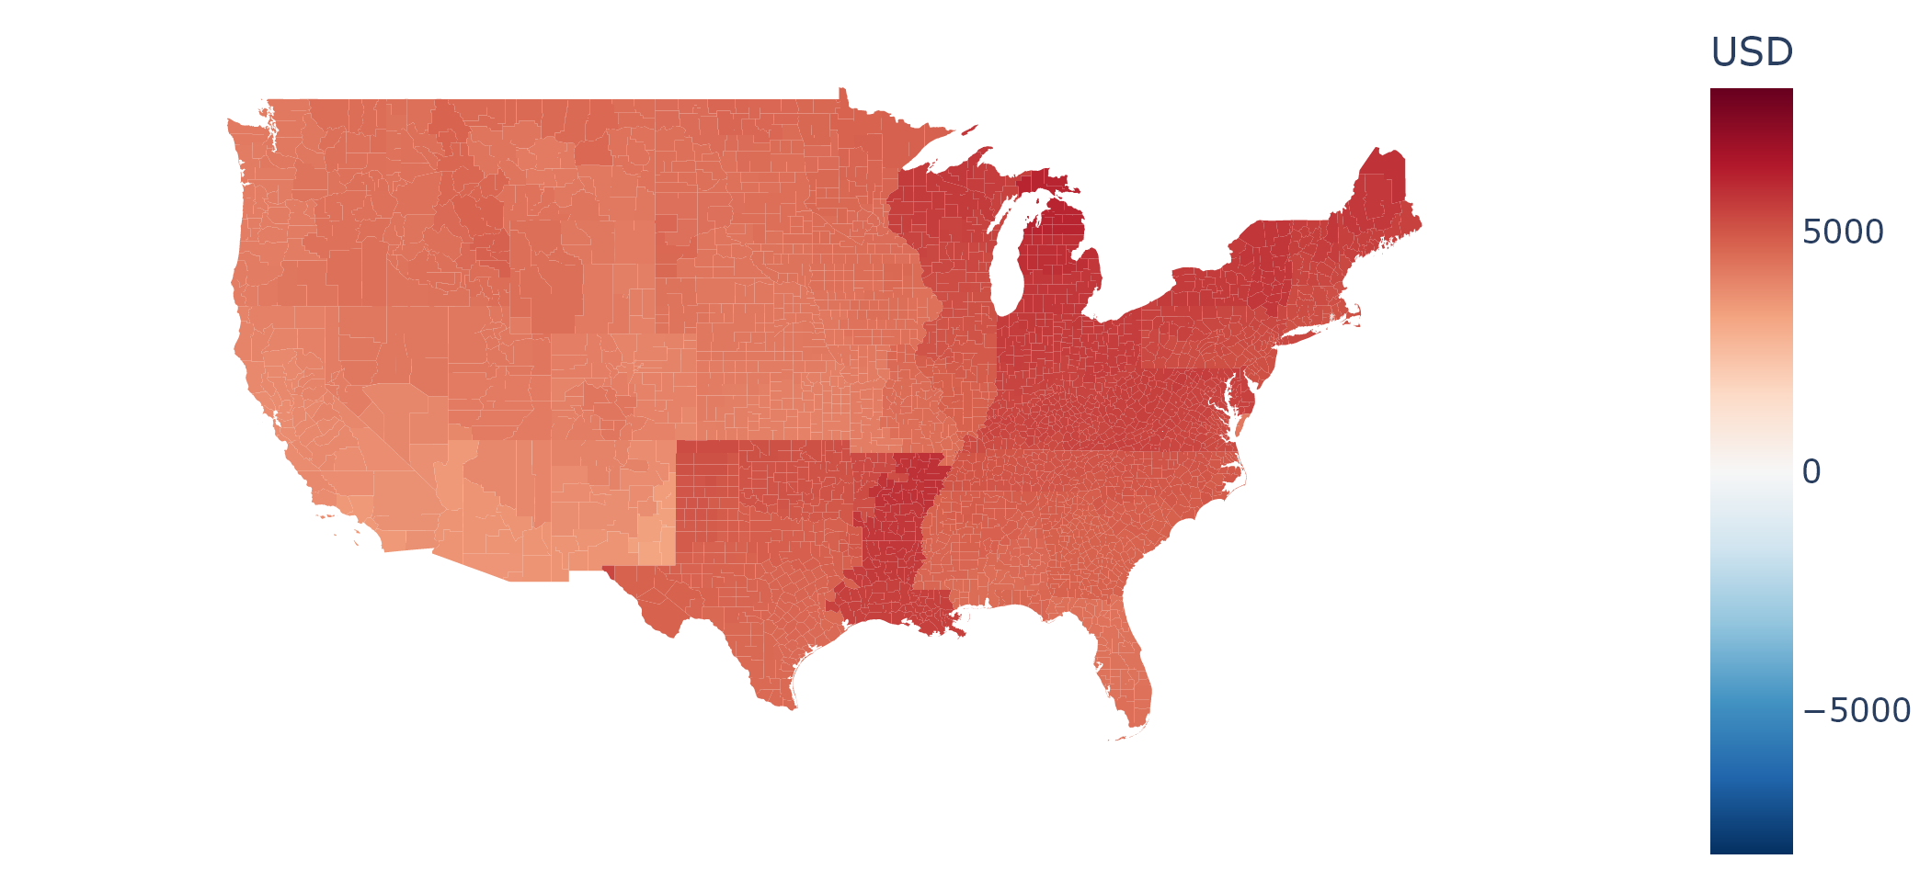
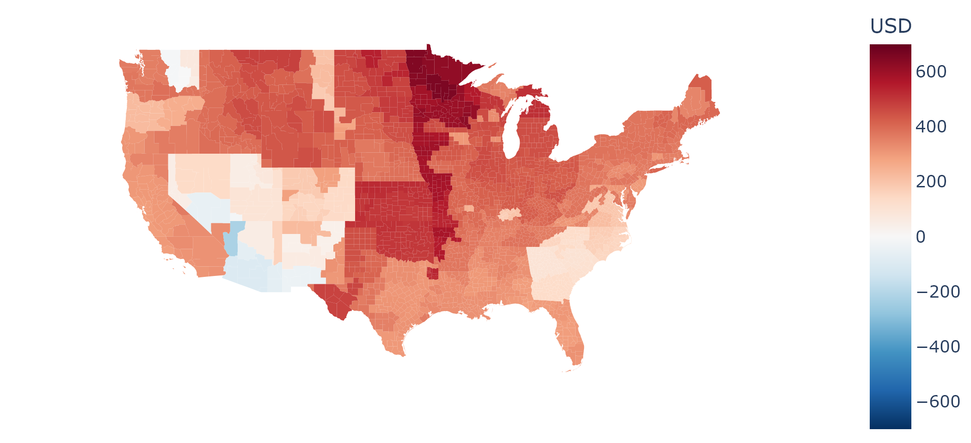
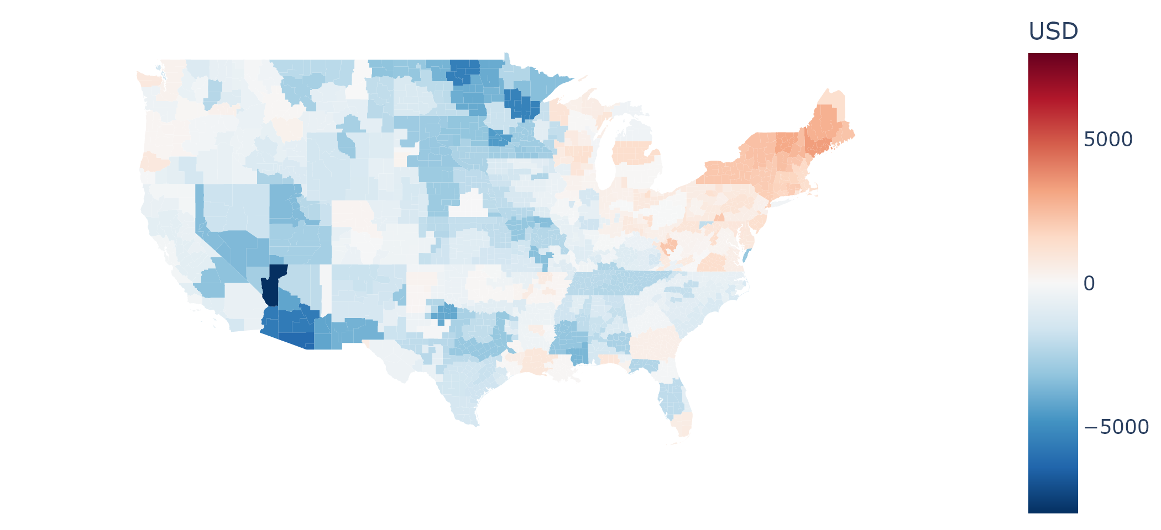
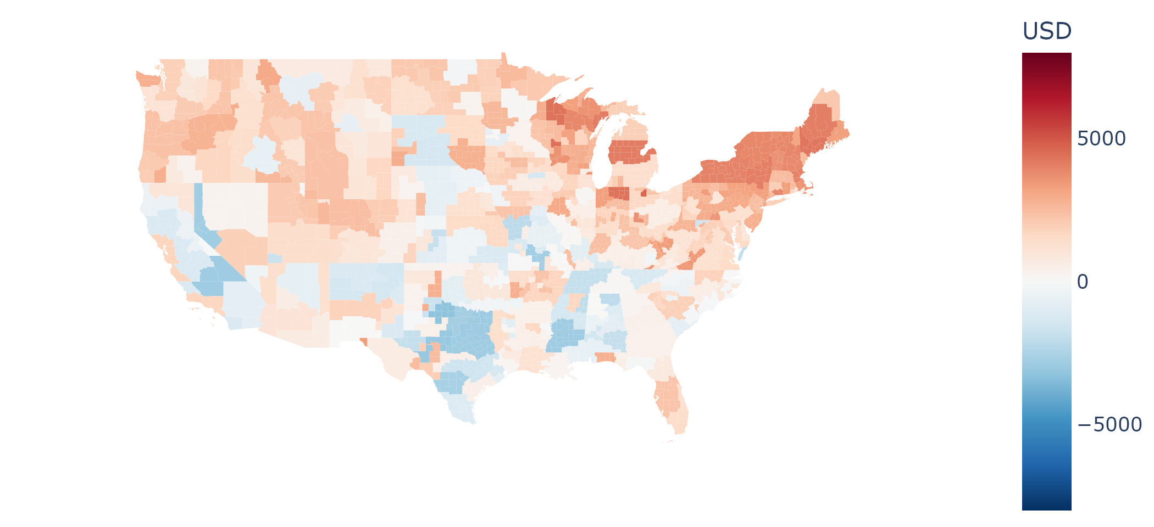
Uncontrolled charging
Controlled charging
USD
8k
V2H
V2H (unelectrified)
0
-8k
Regional median lifetime charging costs of uncontrolled charging users, controlled charging users, V2H users, and V2H users with unelectrified homes across the contiguous USA

Slide 2
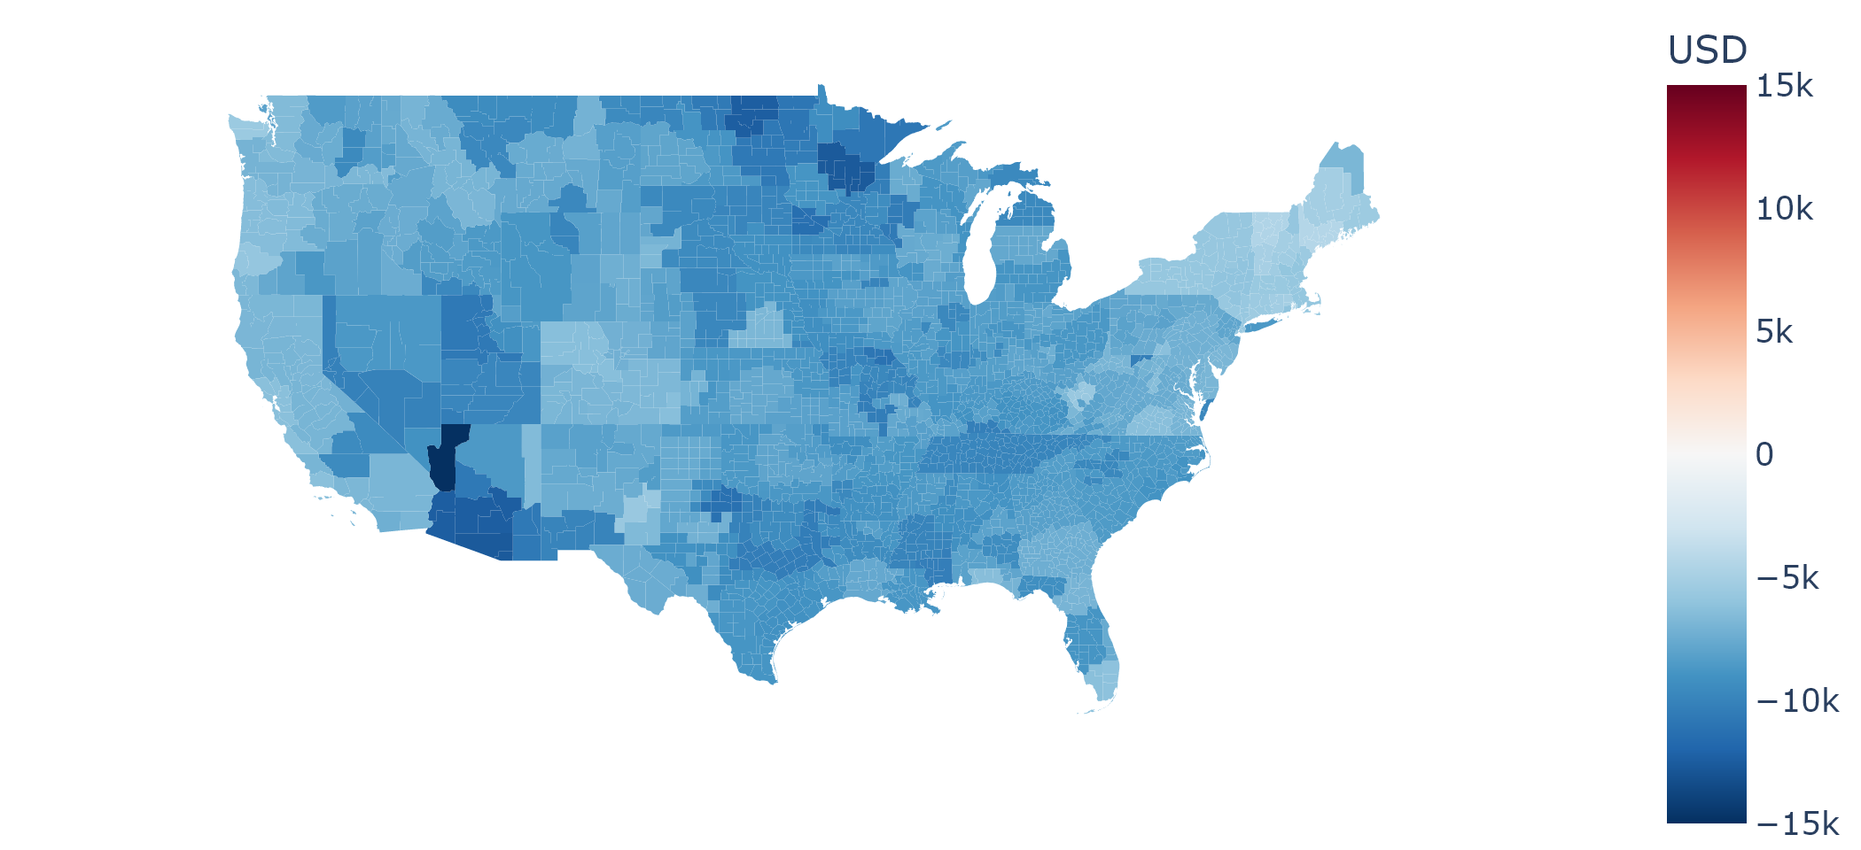
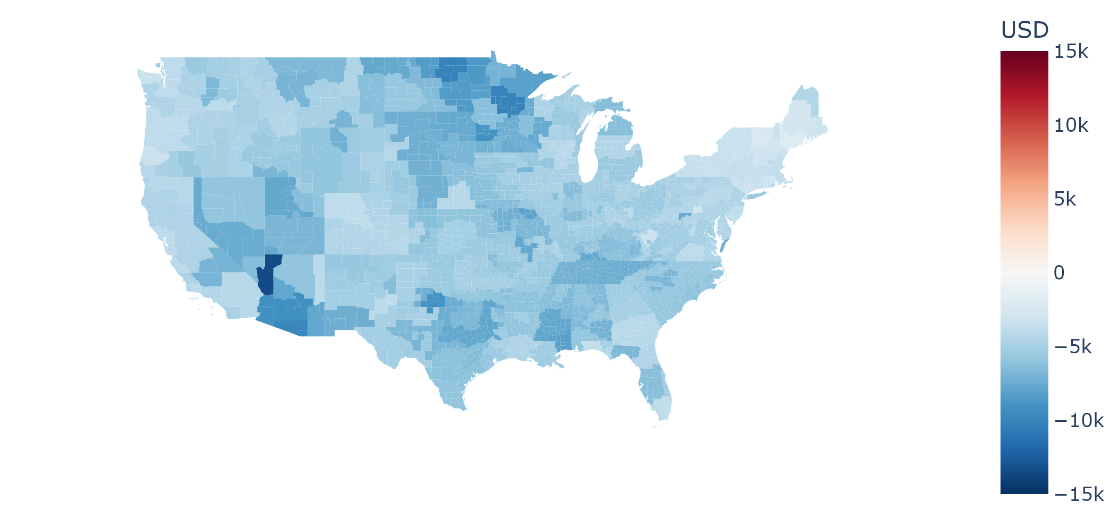
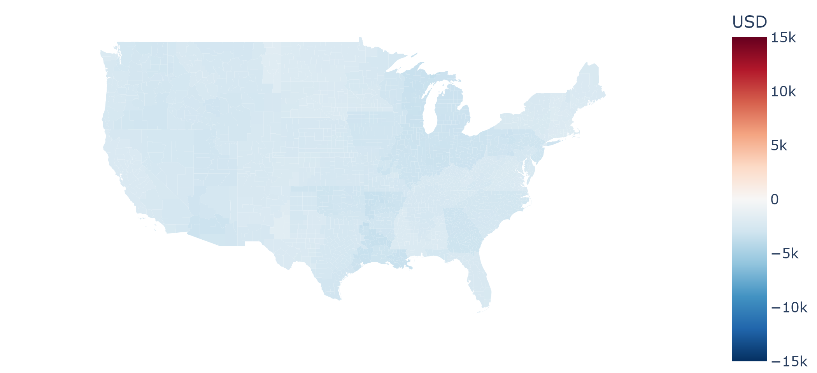
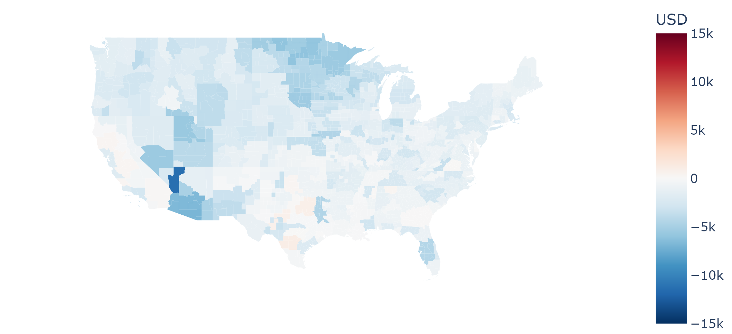
V2H minus
Uncontrolled charging
V2H minus
Controlled charging
USD
15k
Controlled charging vs
Uncontrolled charging
V2H – V2H (unelectrified)
0
-15k
Regional median lifetime charging cost changes of selected pairs of users across the contiguous USA

Slide 3
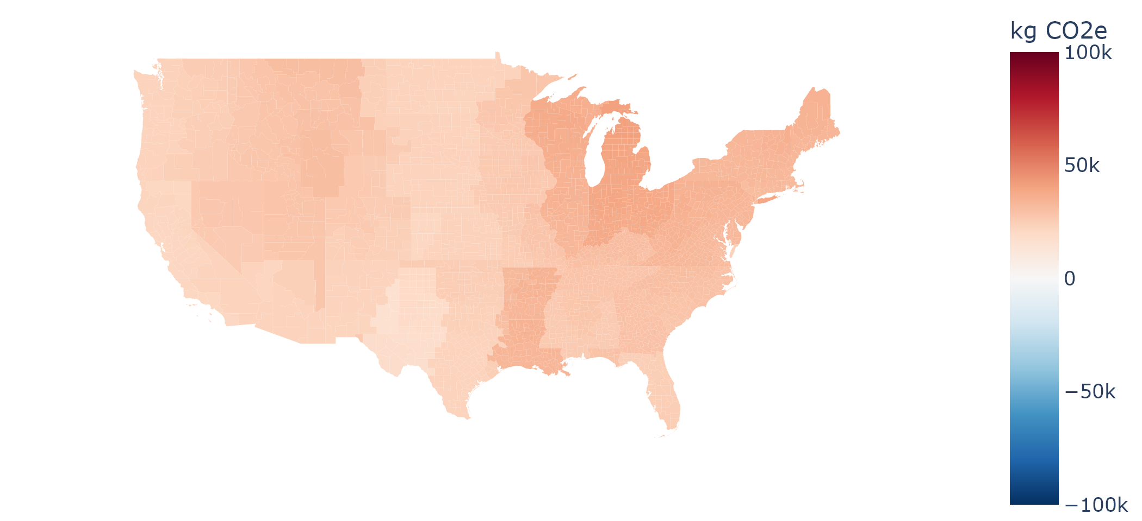
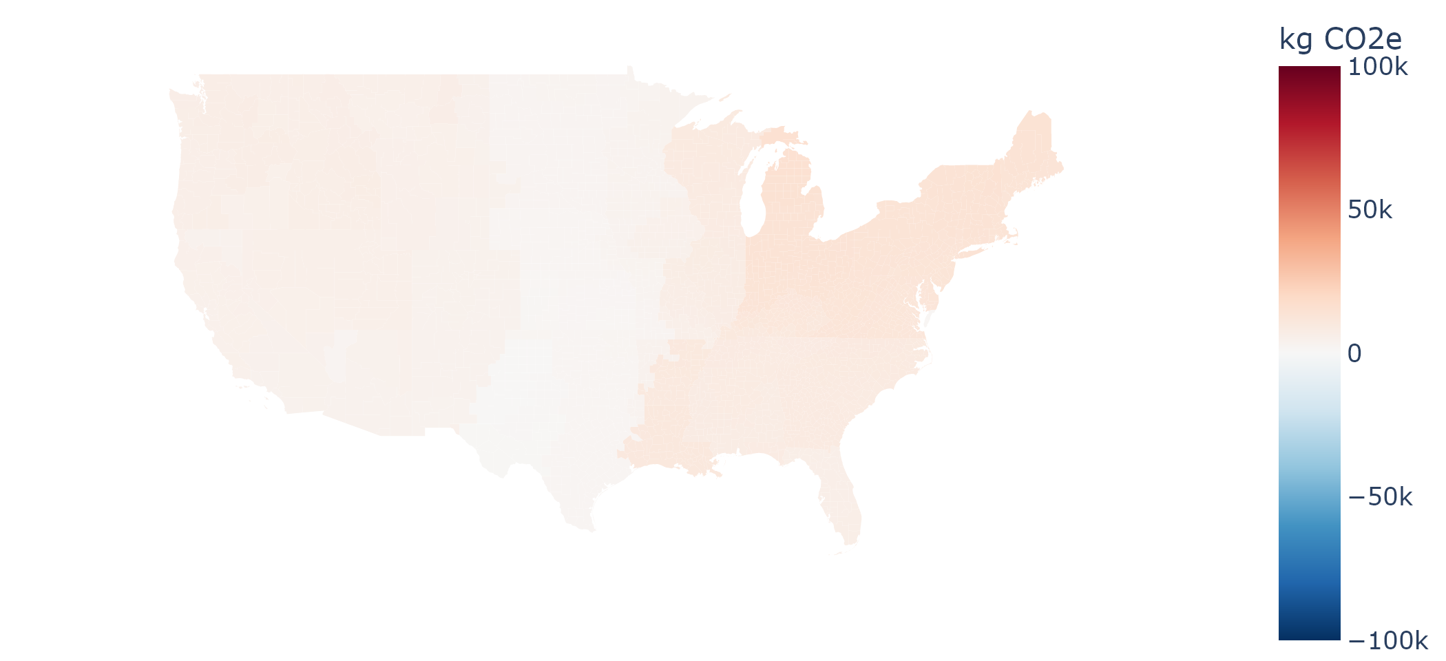
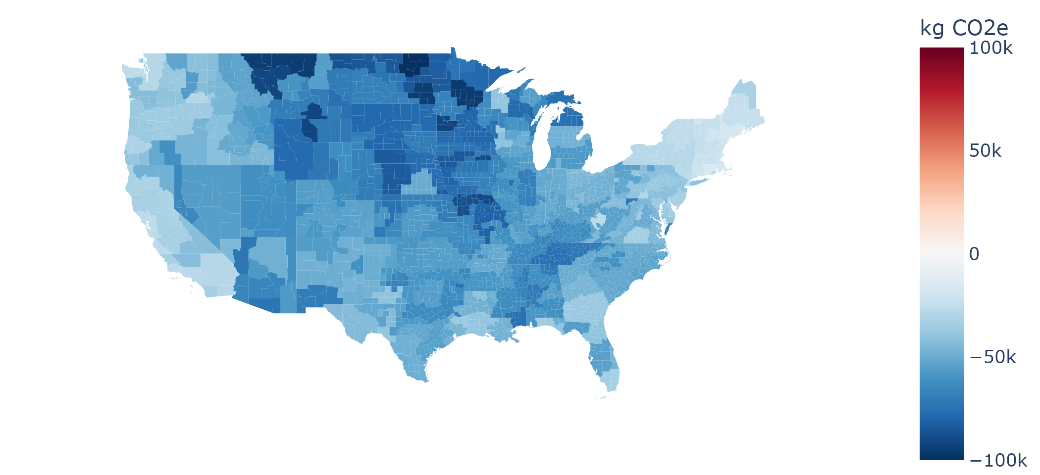
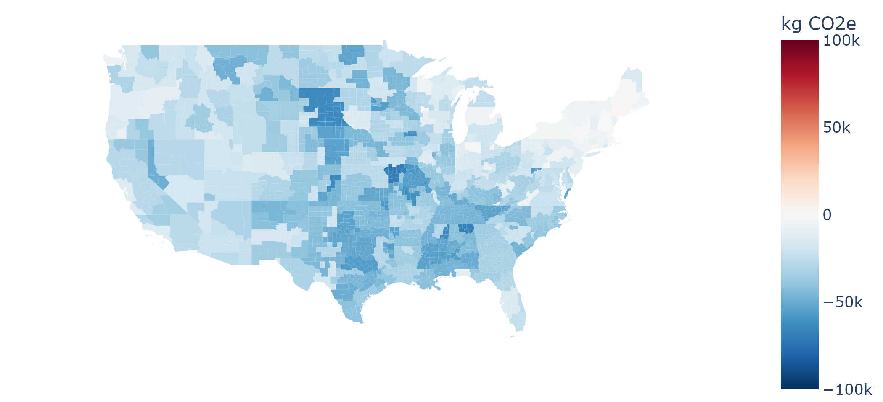
Uncontrolled charging
Controlled charging
t CO₂e
100
V2H
V2H (unelectrified)
0
-100
Regional median lifetime charging emissions of uncontrolled charging users, controlled charging users, V2H users, and V2H users with unelectrified homes across the contiguous USA

Slide 4
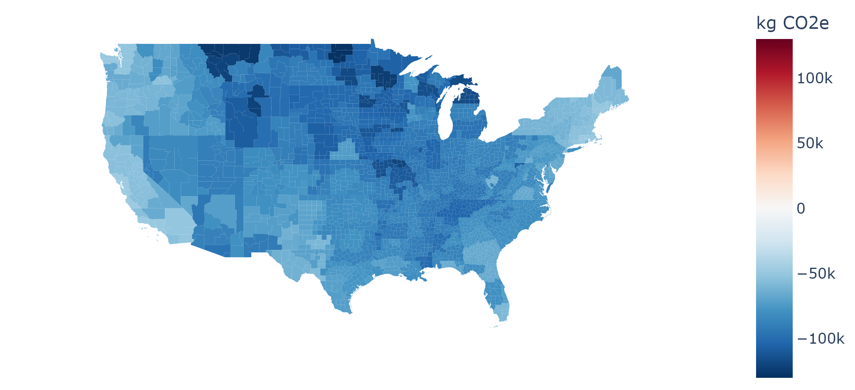
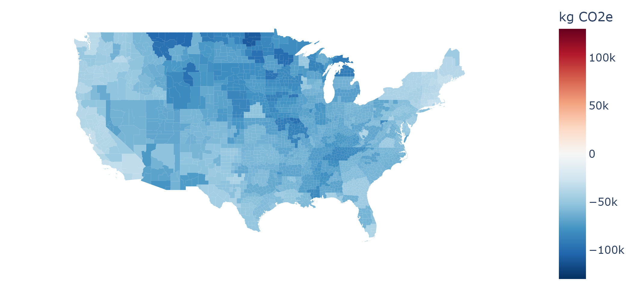
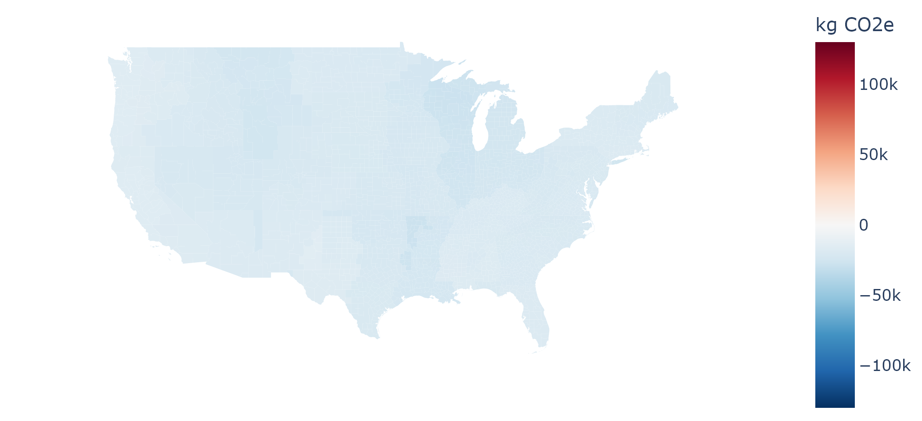
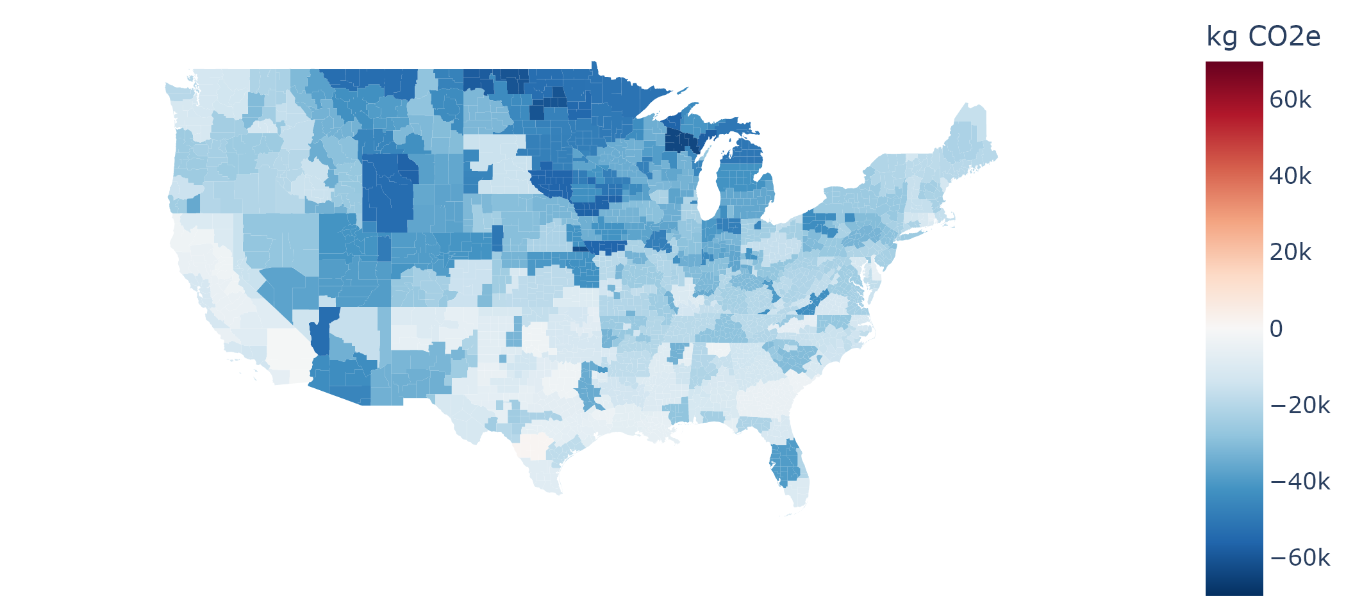
V2H minus
Uncontrolled charging
V2H minus
Controlled charging
t CO₂e
130
Controlled charging vs
Uncontrolled charging
V2H – V2H (unelectrified)
0
-130
Regional median lifetime charging emission changes of selected pairs of users across the contiguous USA

Slide 5
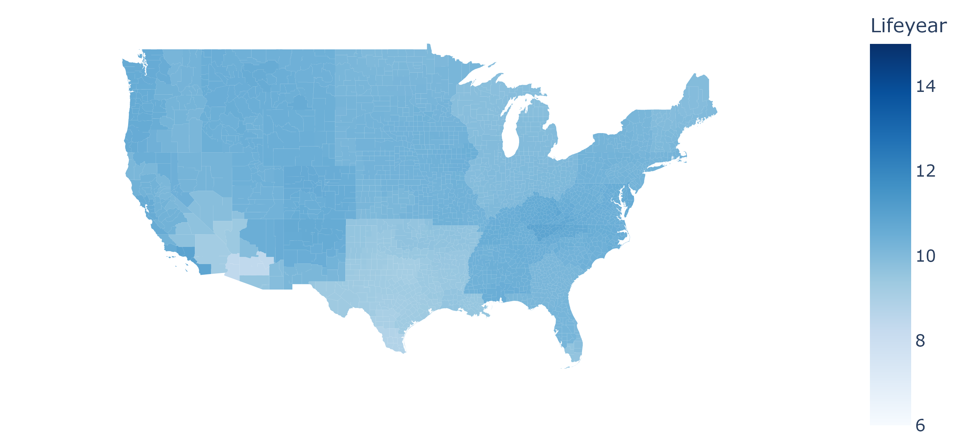
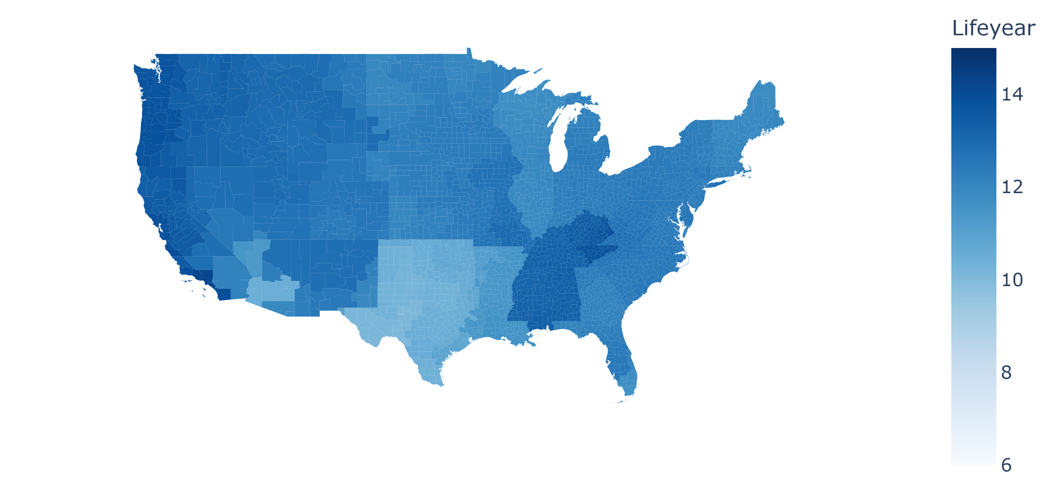
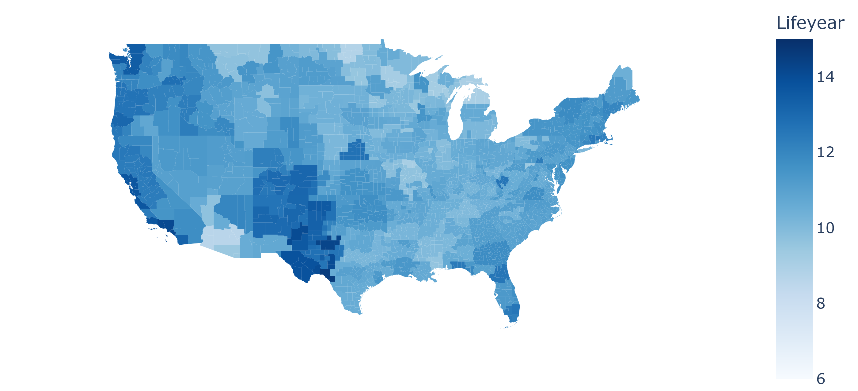
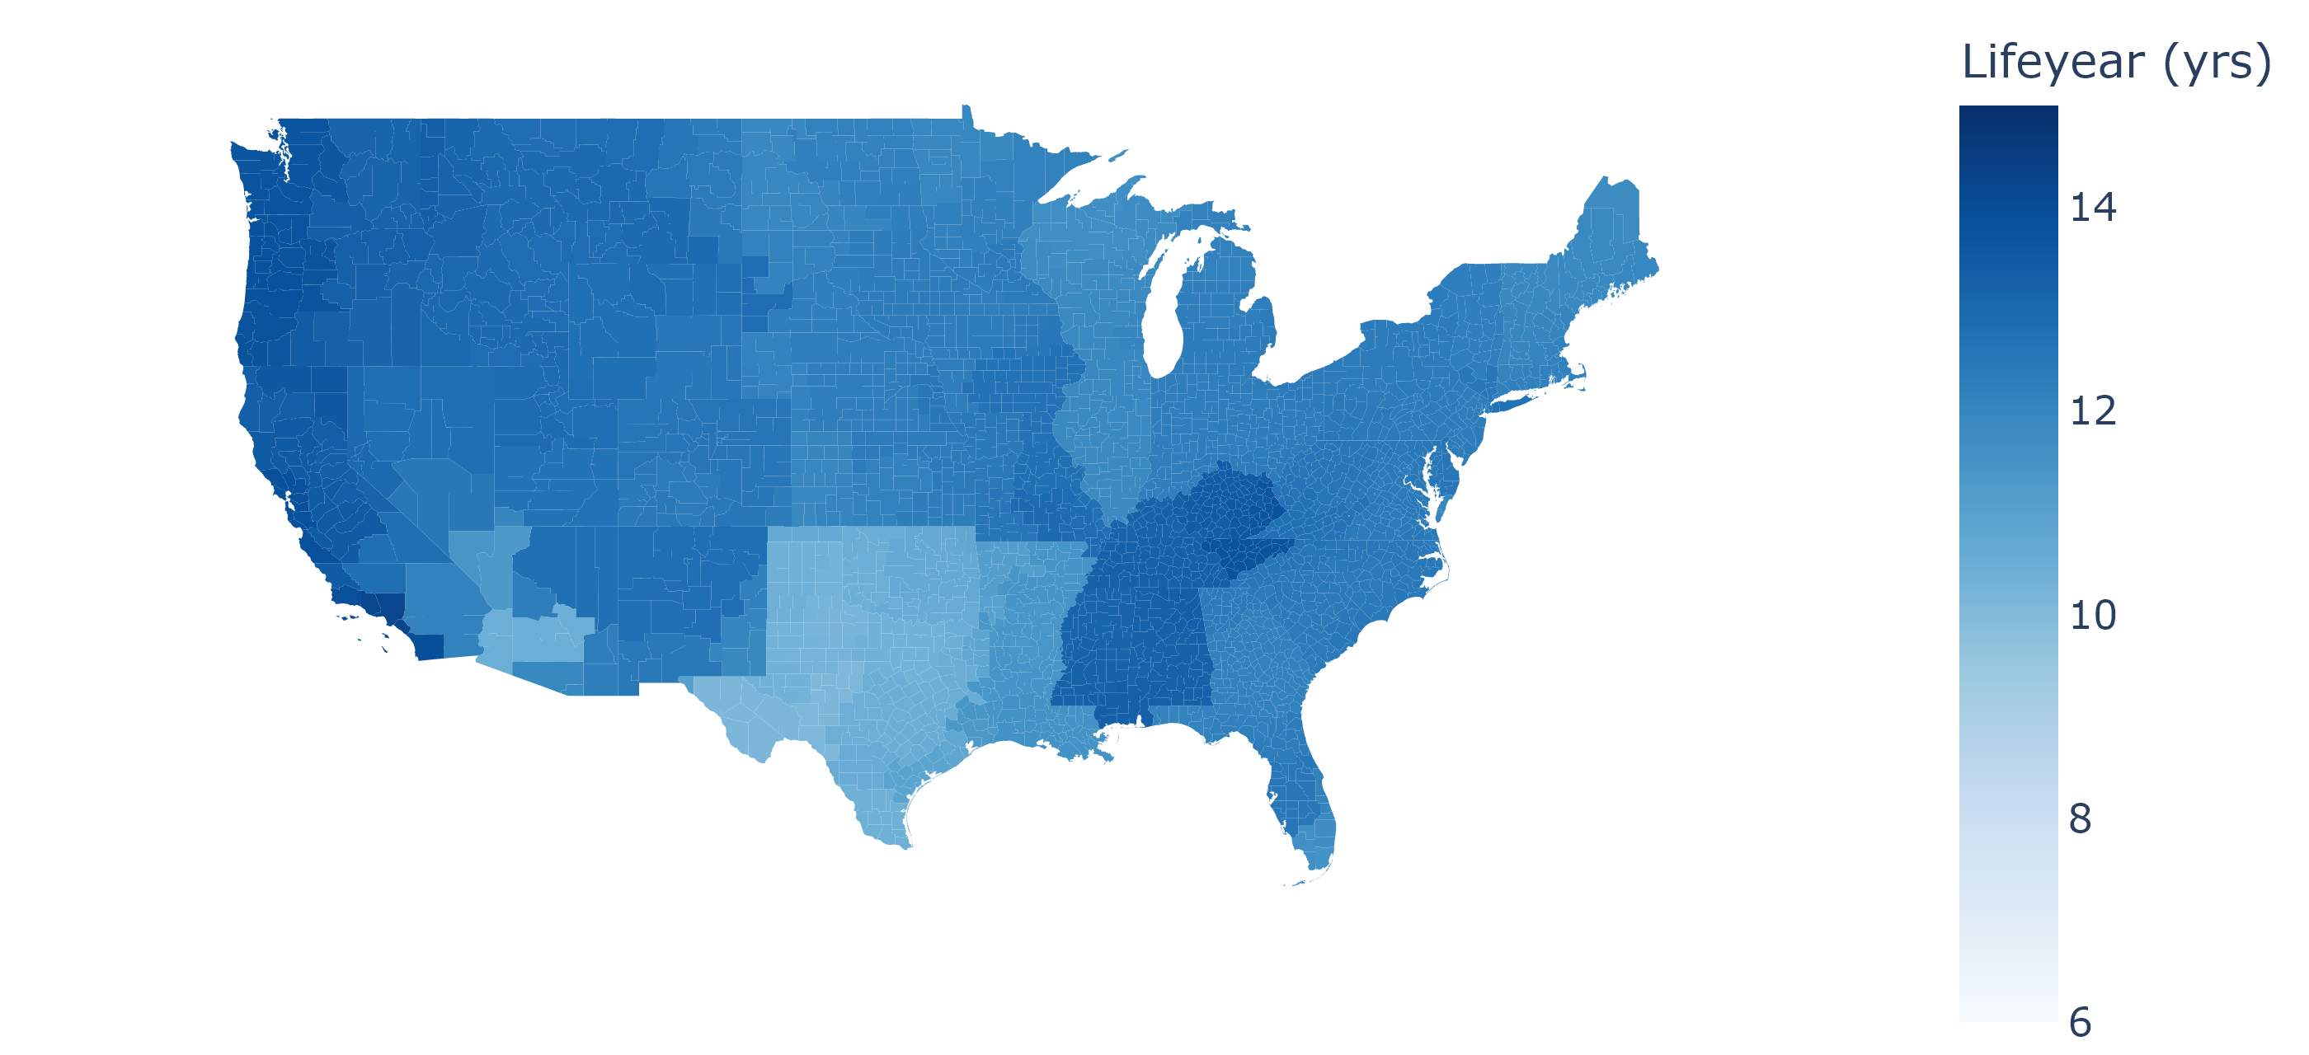
Uncontrolled charging
Controlled charging
V2H
Life (yr)
V2H
15
6

Slide 6
Figure showcase

Slide 7
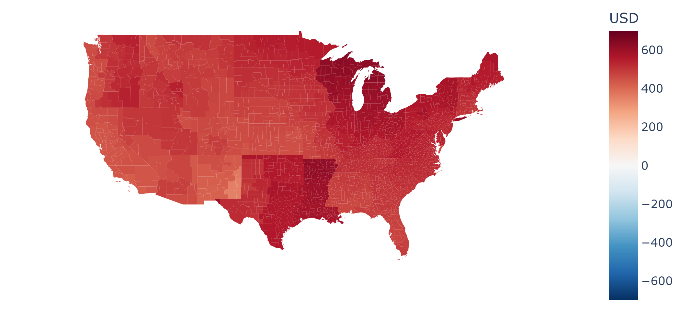
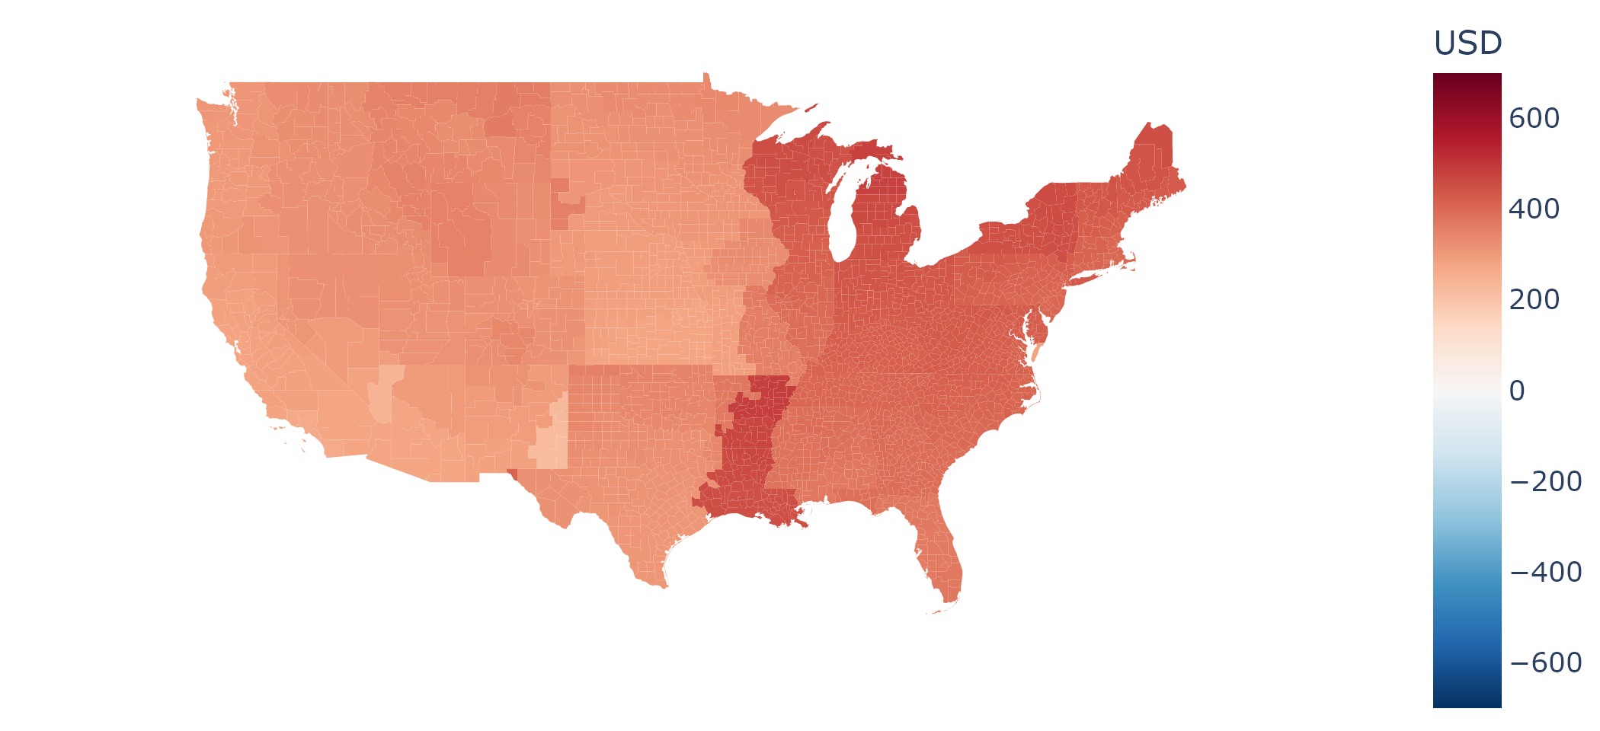
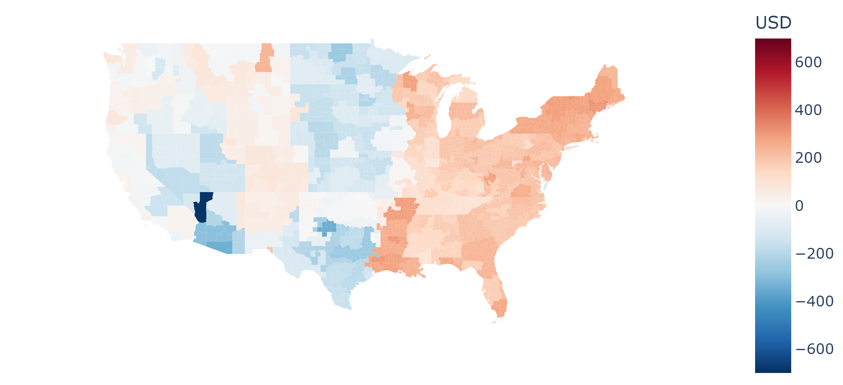
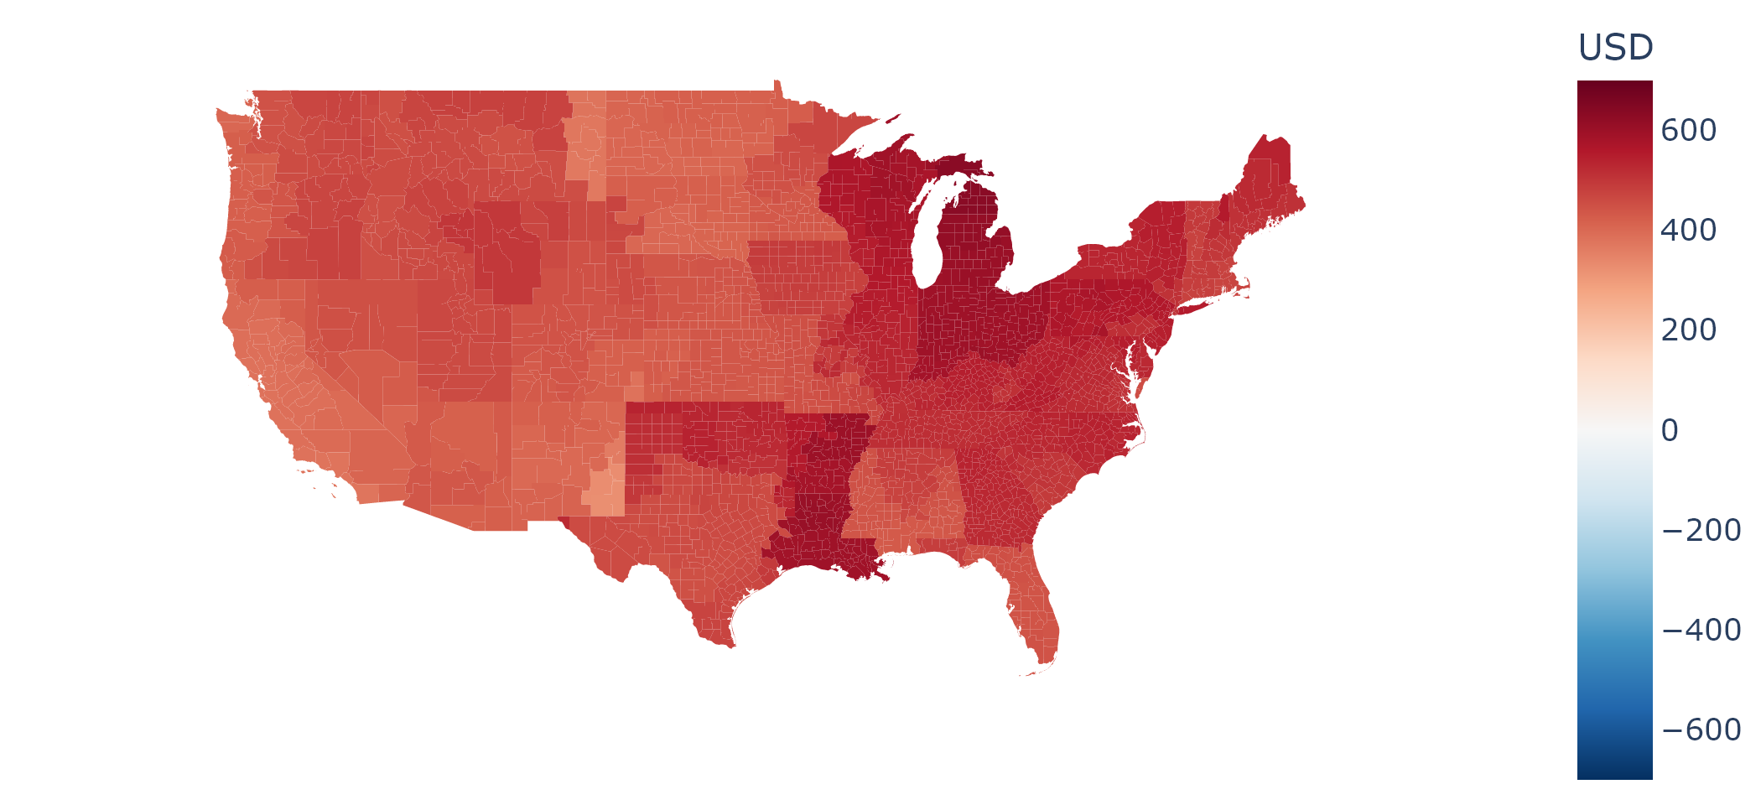
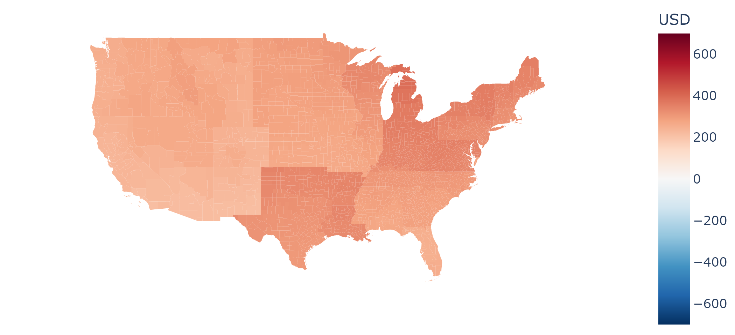
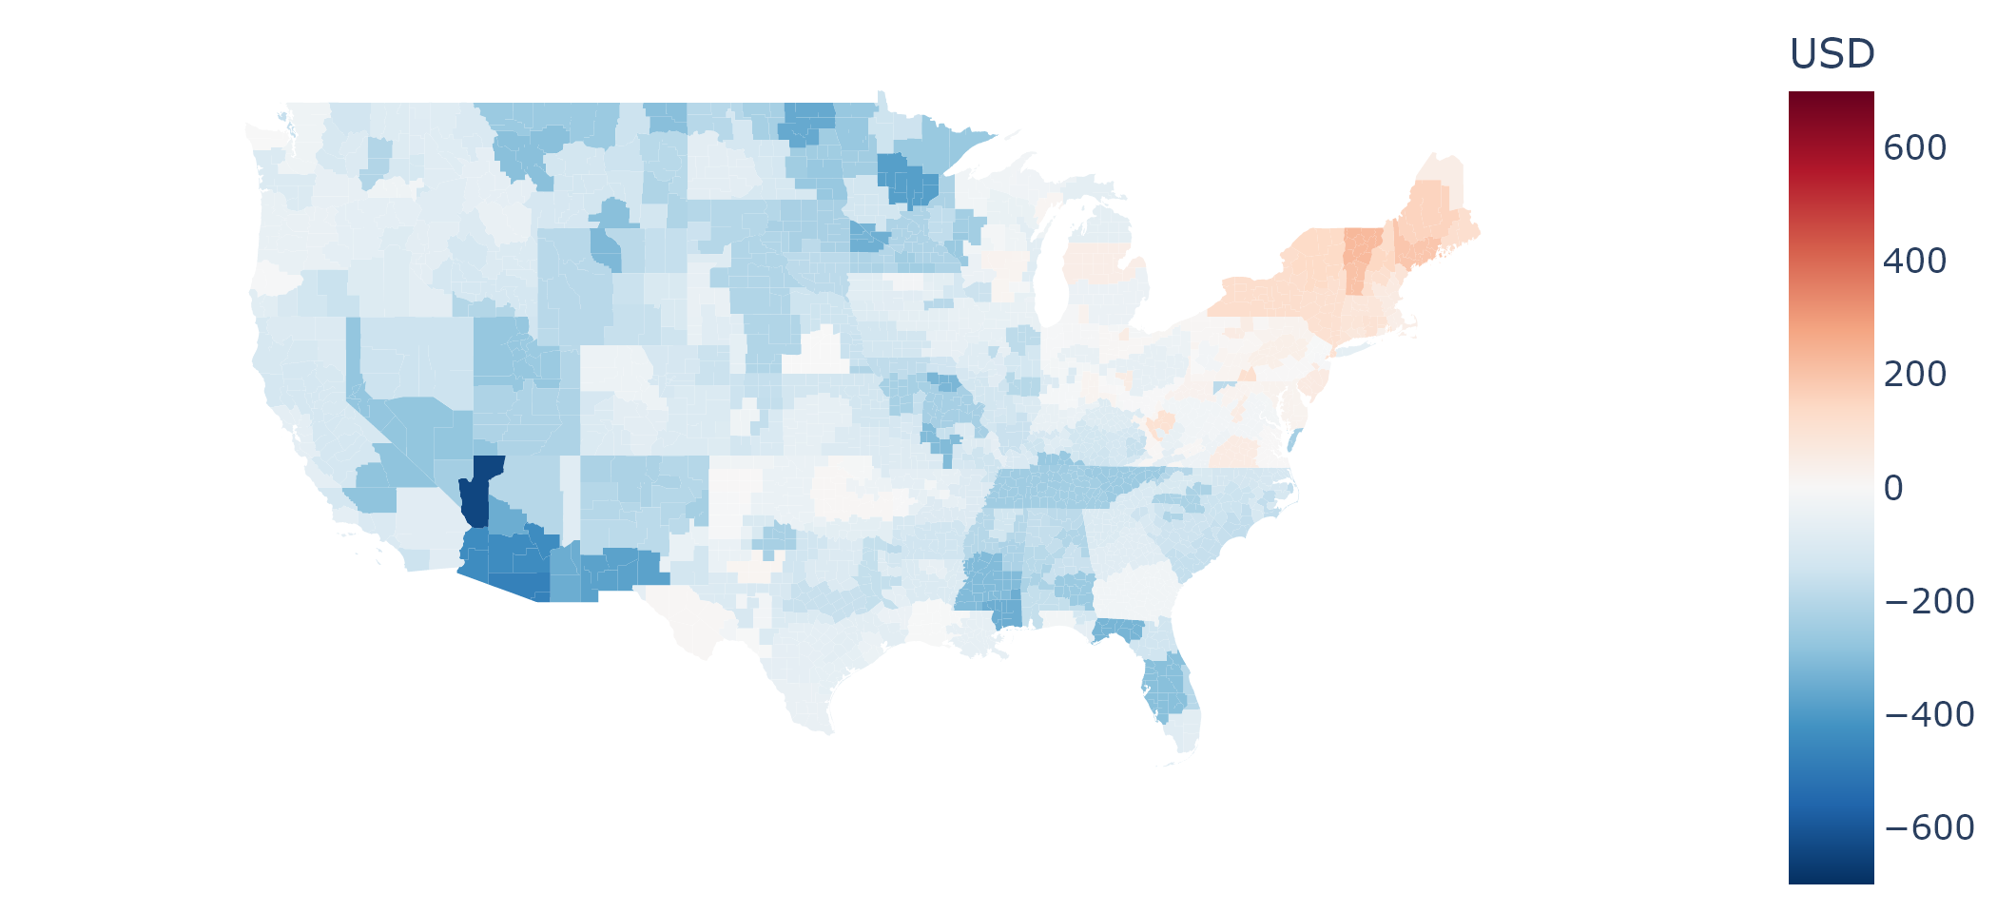

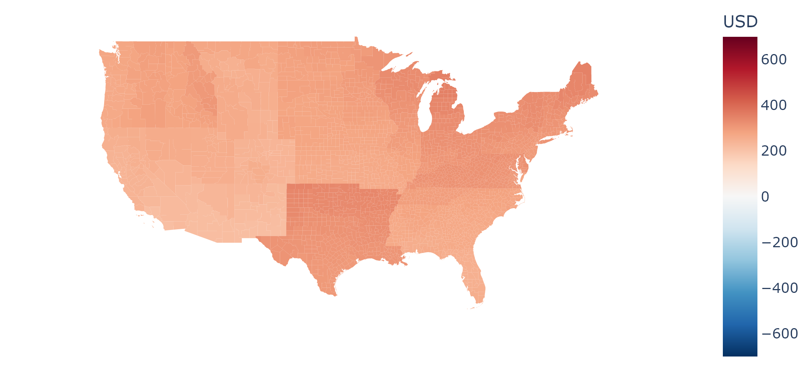
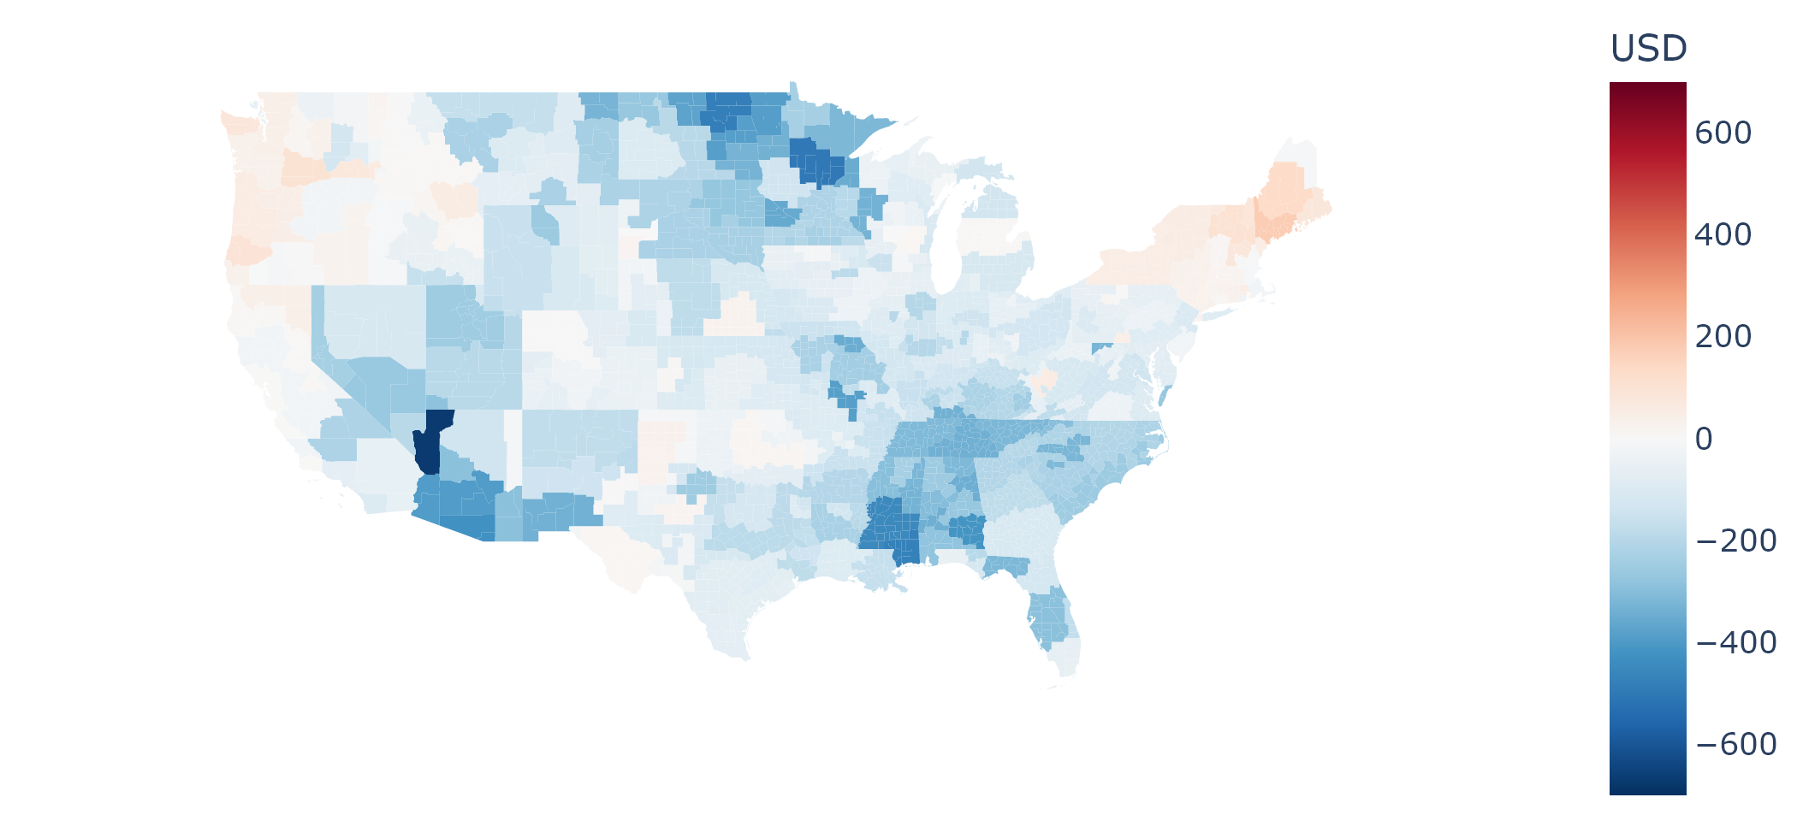
Uncontrolled charging
Controlled charging
V2H
USD
700
2024
2030
0
2040
-700
8k
Lifetime
0
-8k
Figure 1 Median annual charging costs and median lifetime charging costs for individual PEVs, of each region across the US. Charging costs are defined as net increase in electricity bills of the whole home with PEV charging. 2024, 2030 and 2040 are modeled annual results. Results for PEVs with charging modes of uncontrolled charging, controlled charging and V2H are displayed .

Slide 8
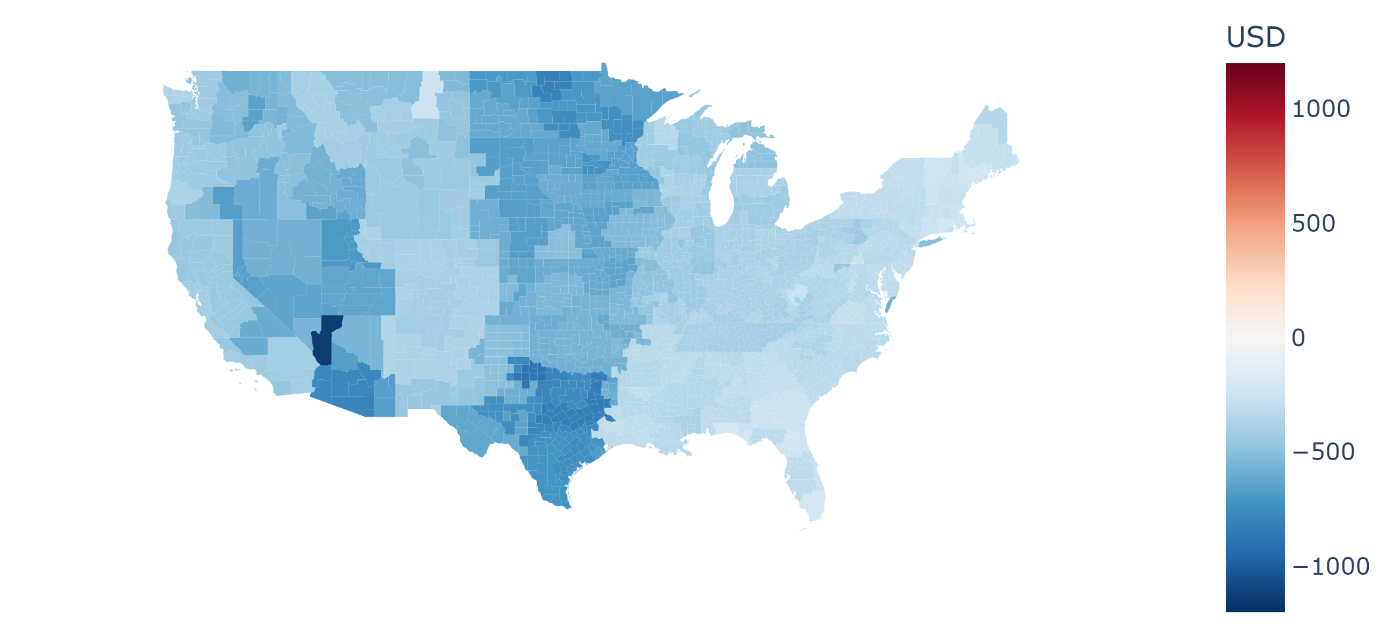
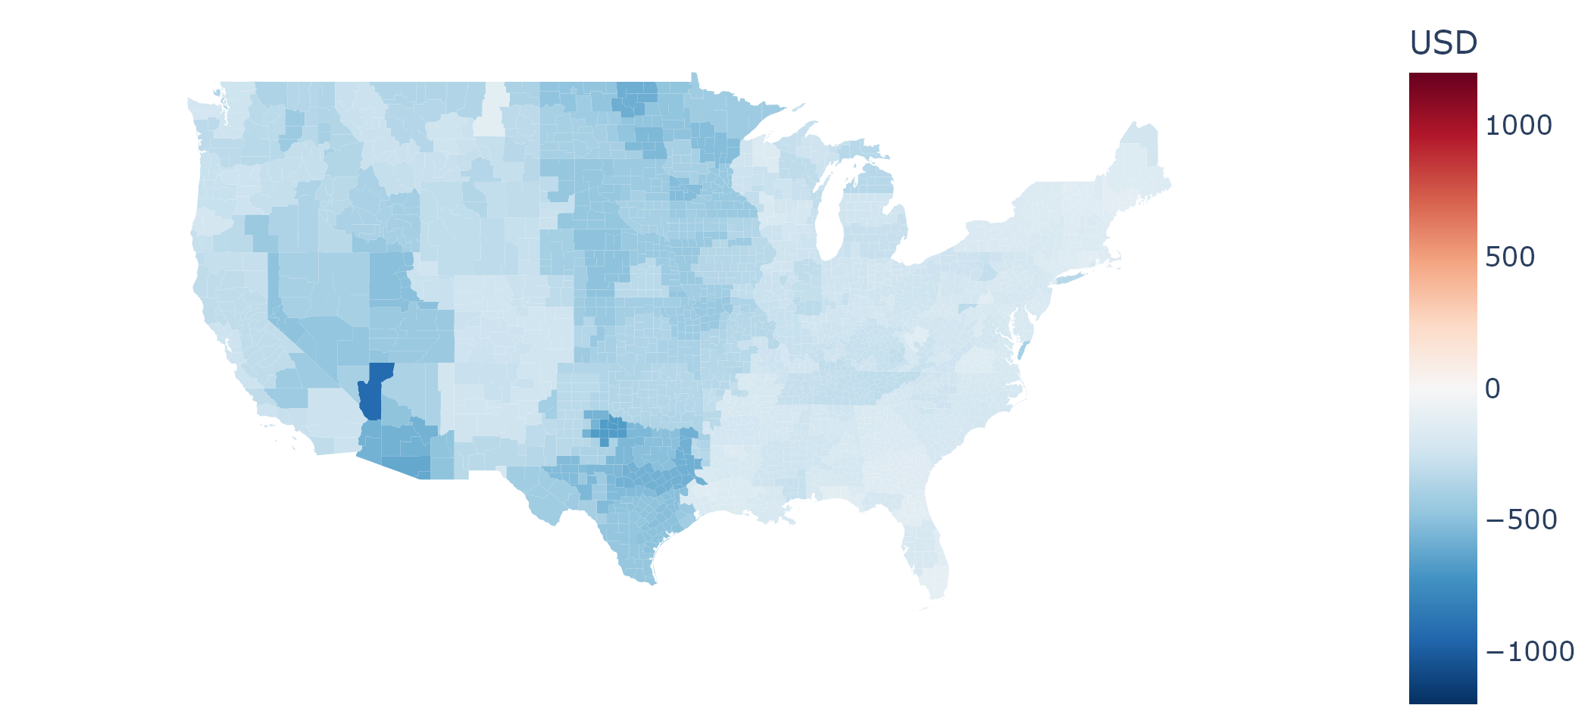
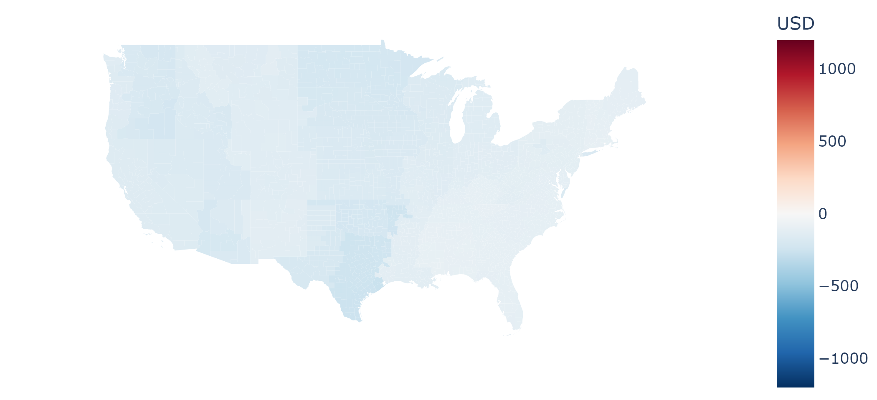
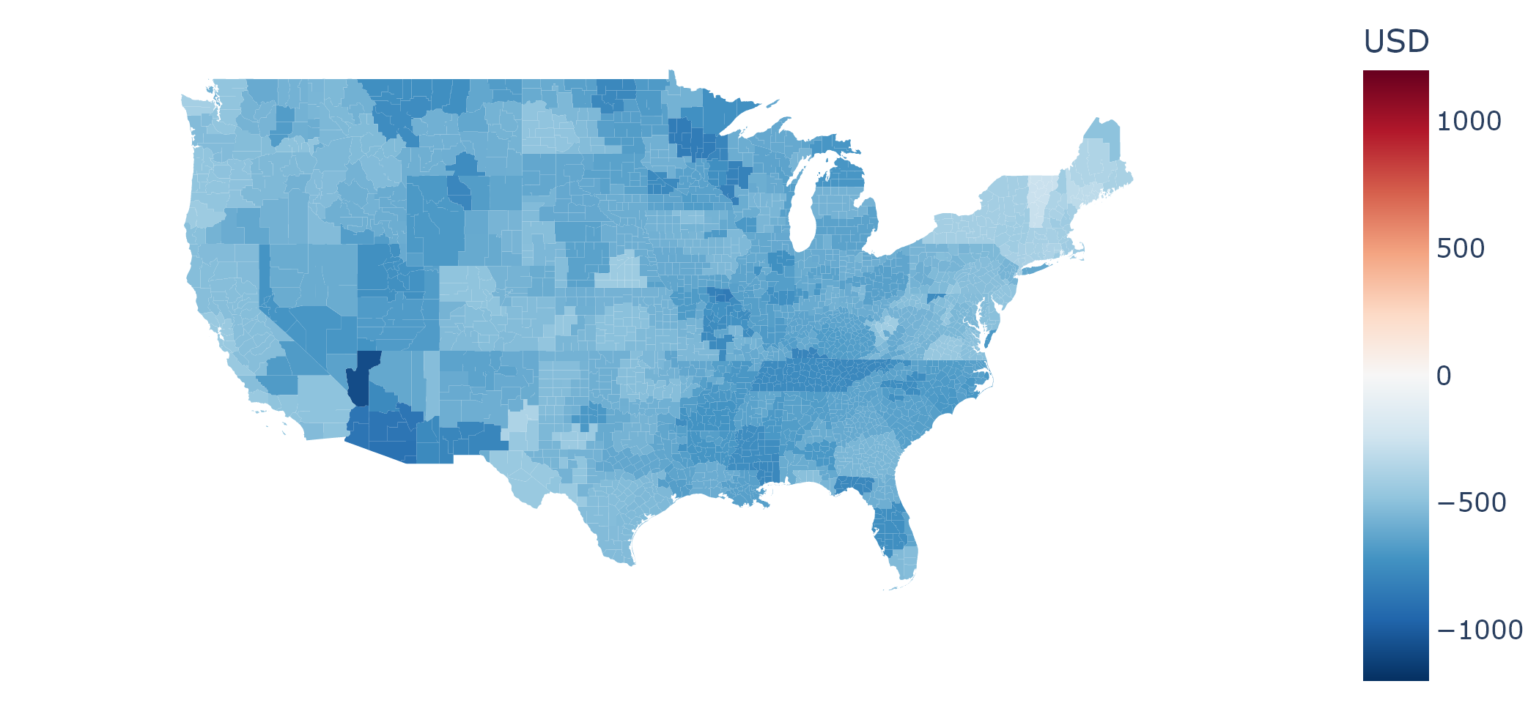
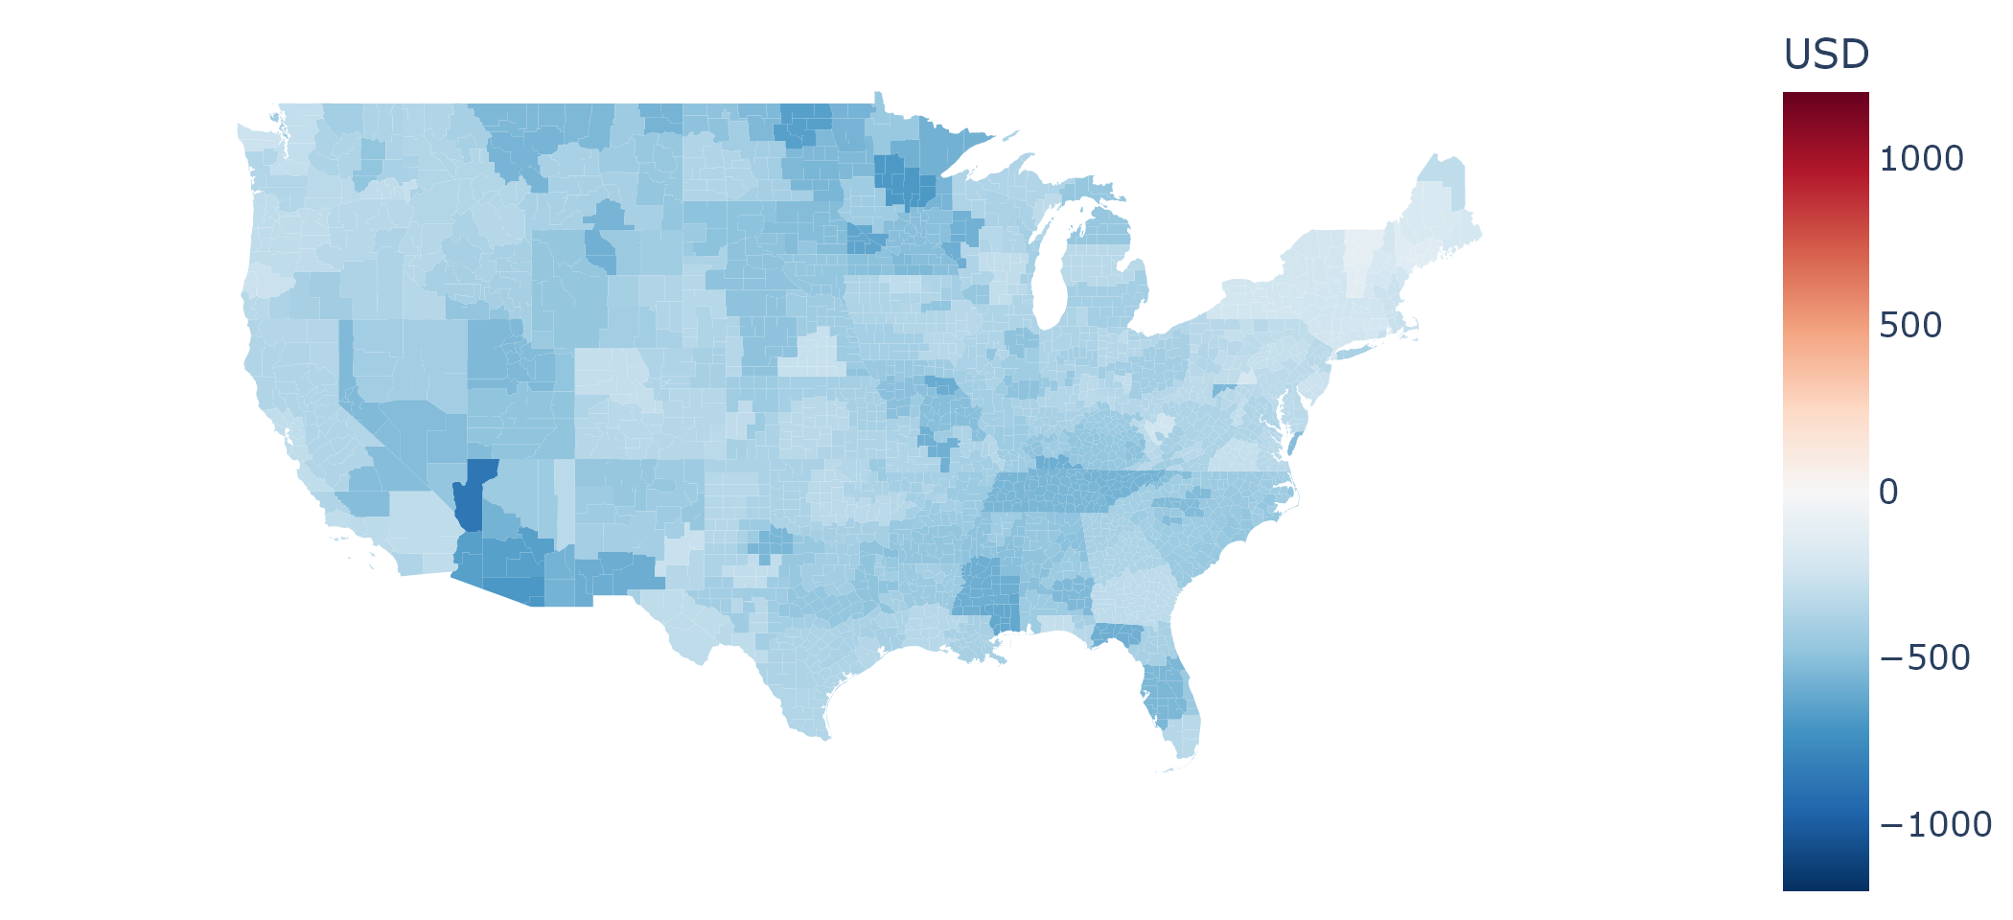
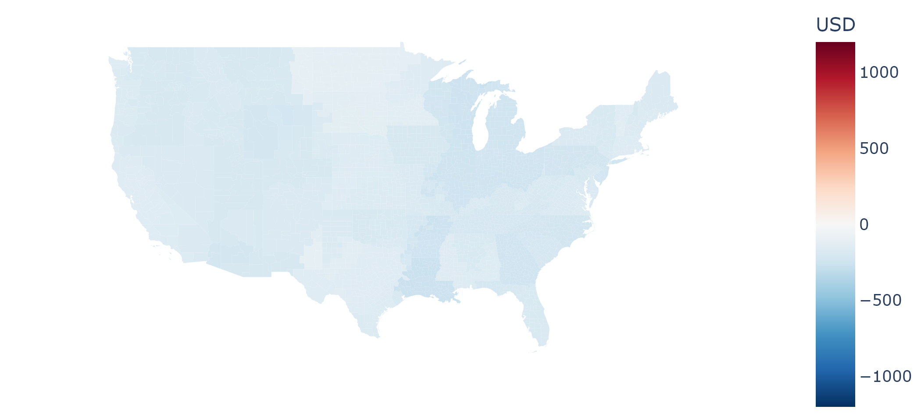
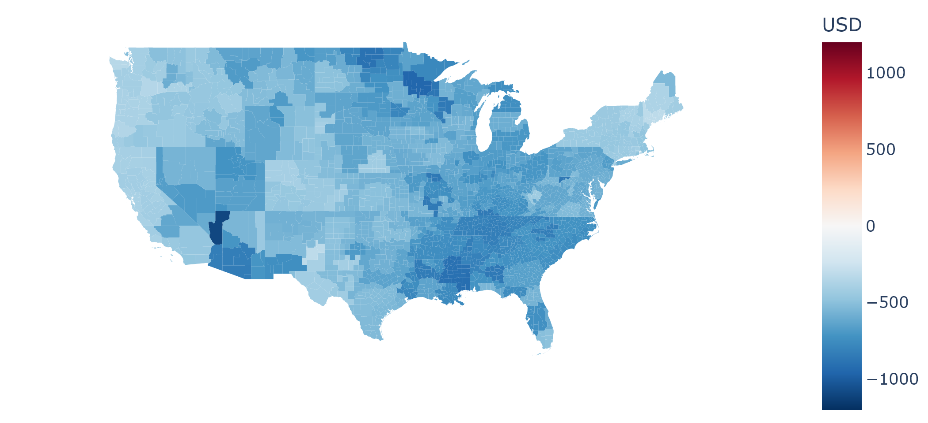
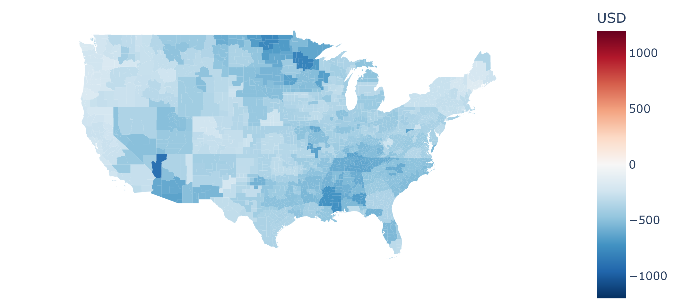

V2H minus
Uncontrolled charging
V2H minus
Controlled charging
Controlled charging minus
Uncontrolled charging
USD
1200
2024
2030
0
2040
-1200
15k
Lifetime
0
-15k

Slide 9
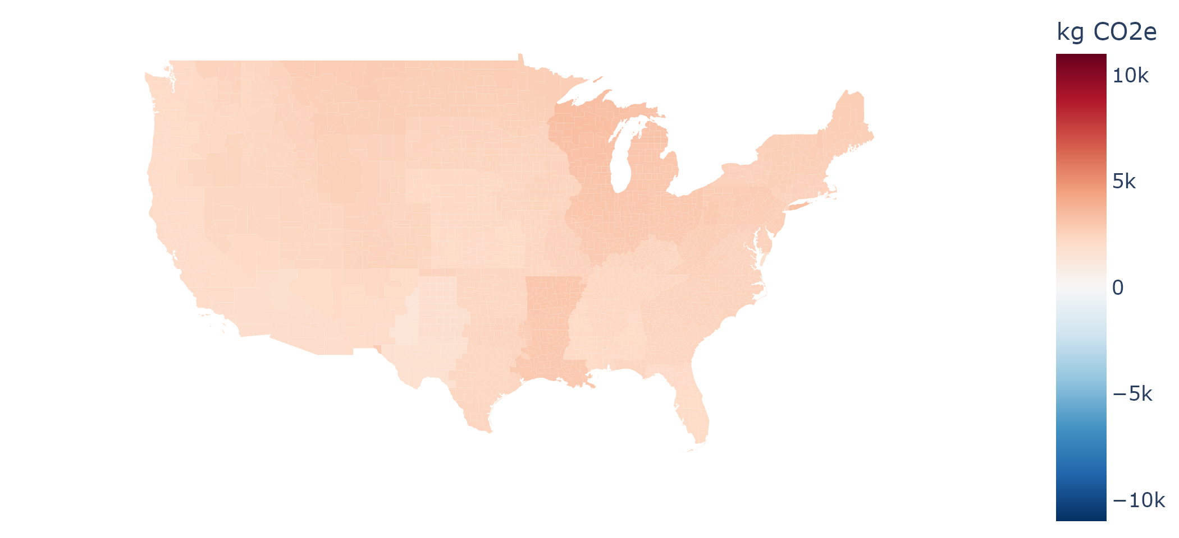
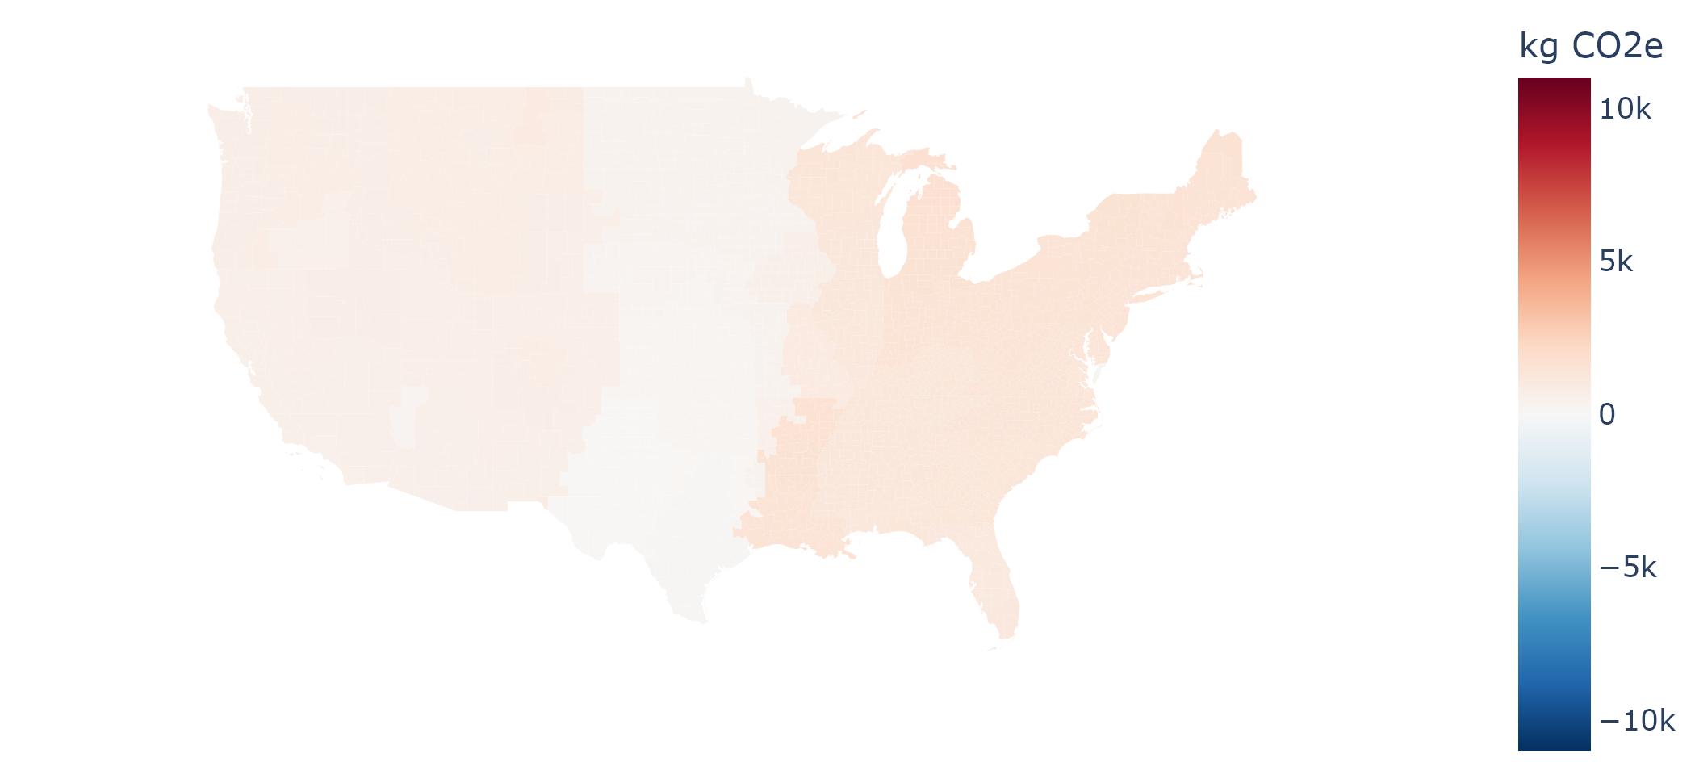
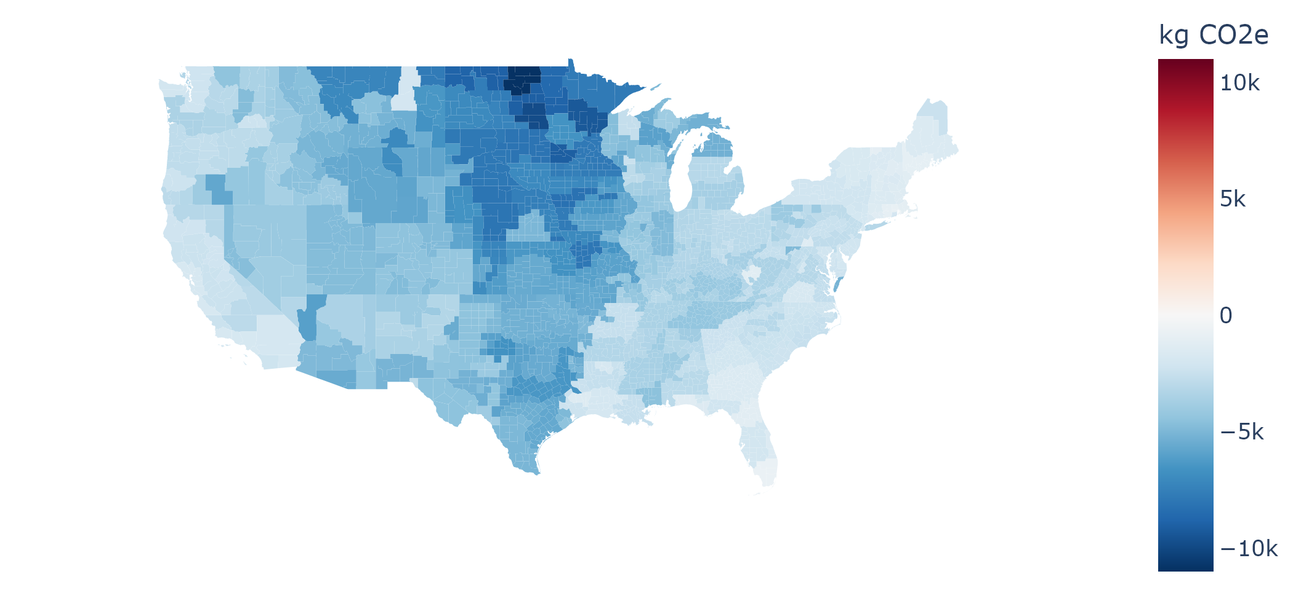
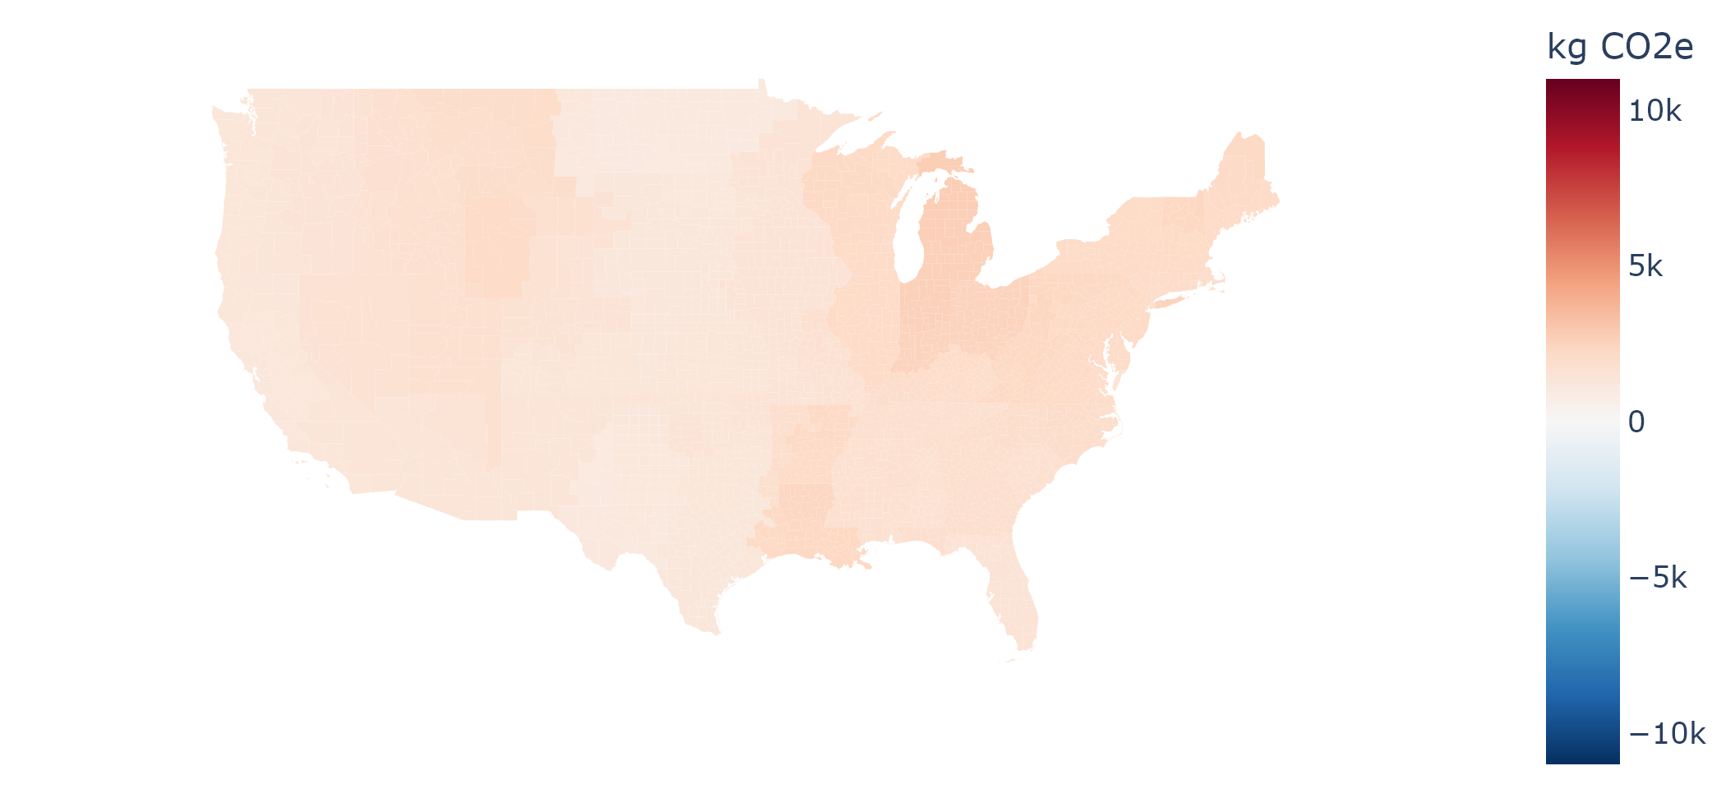
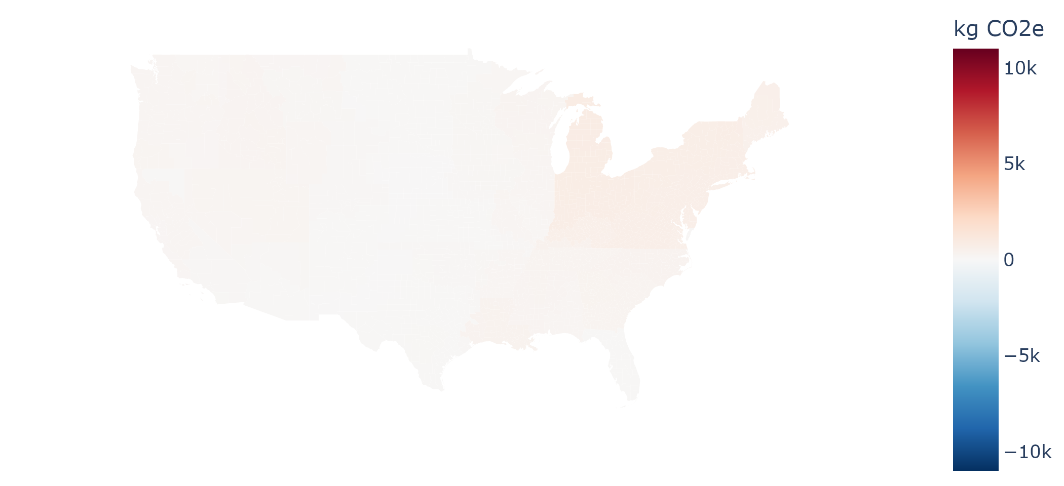
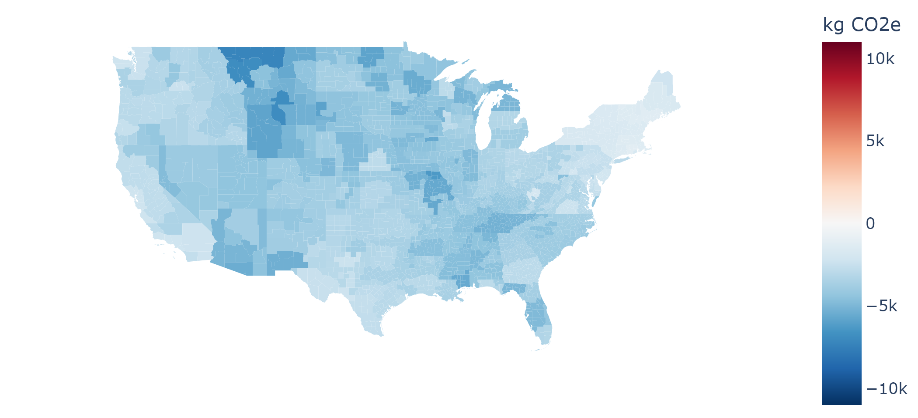

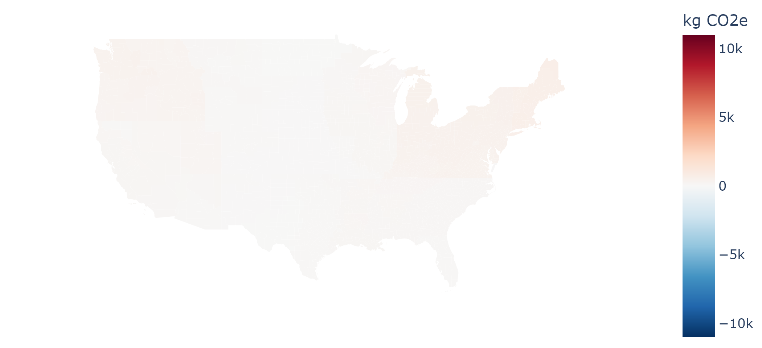
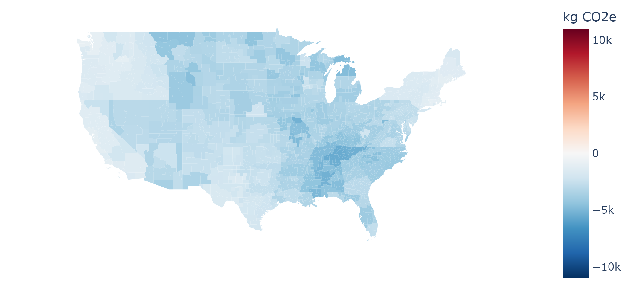
Uncontrolled charging
Controlled charging
V2H
t CO₂e
15
2024
2030
0
2040
-15
100
Lifetime
0
-100

Slide 10
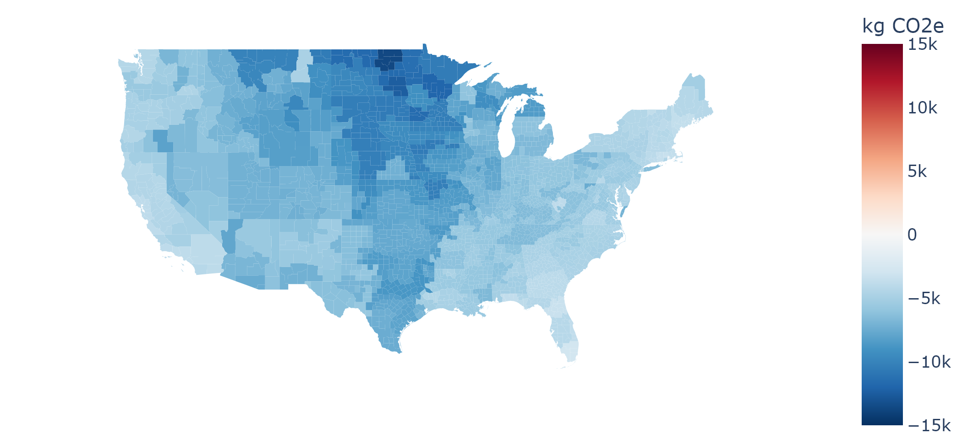
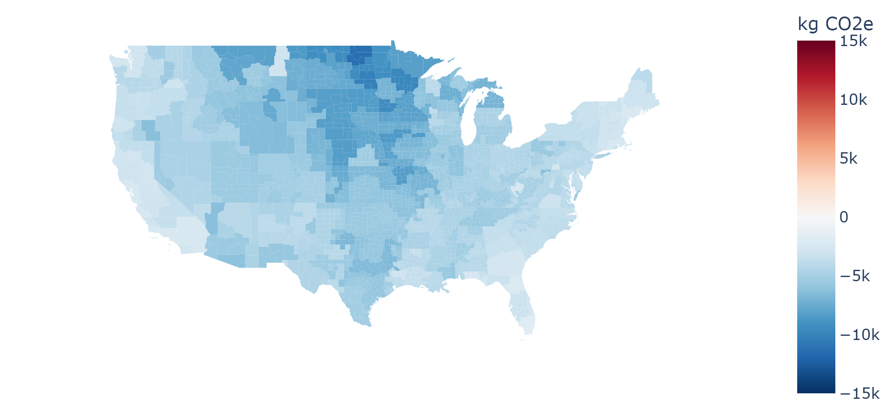
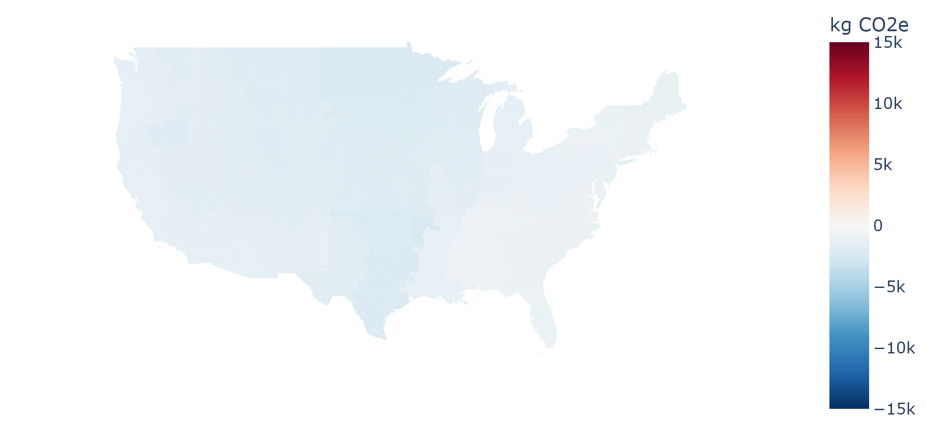
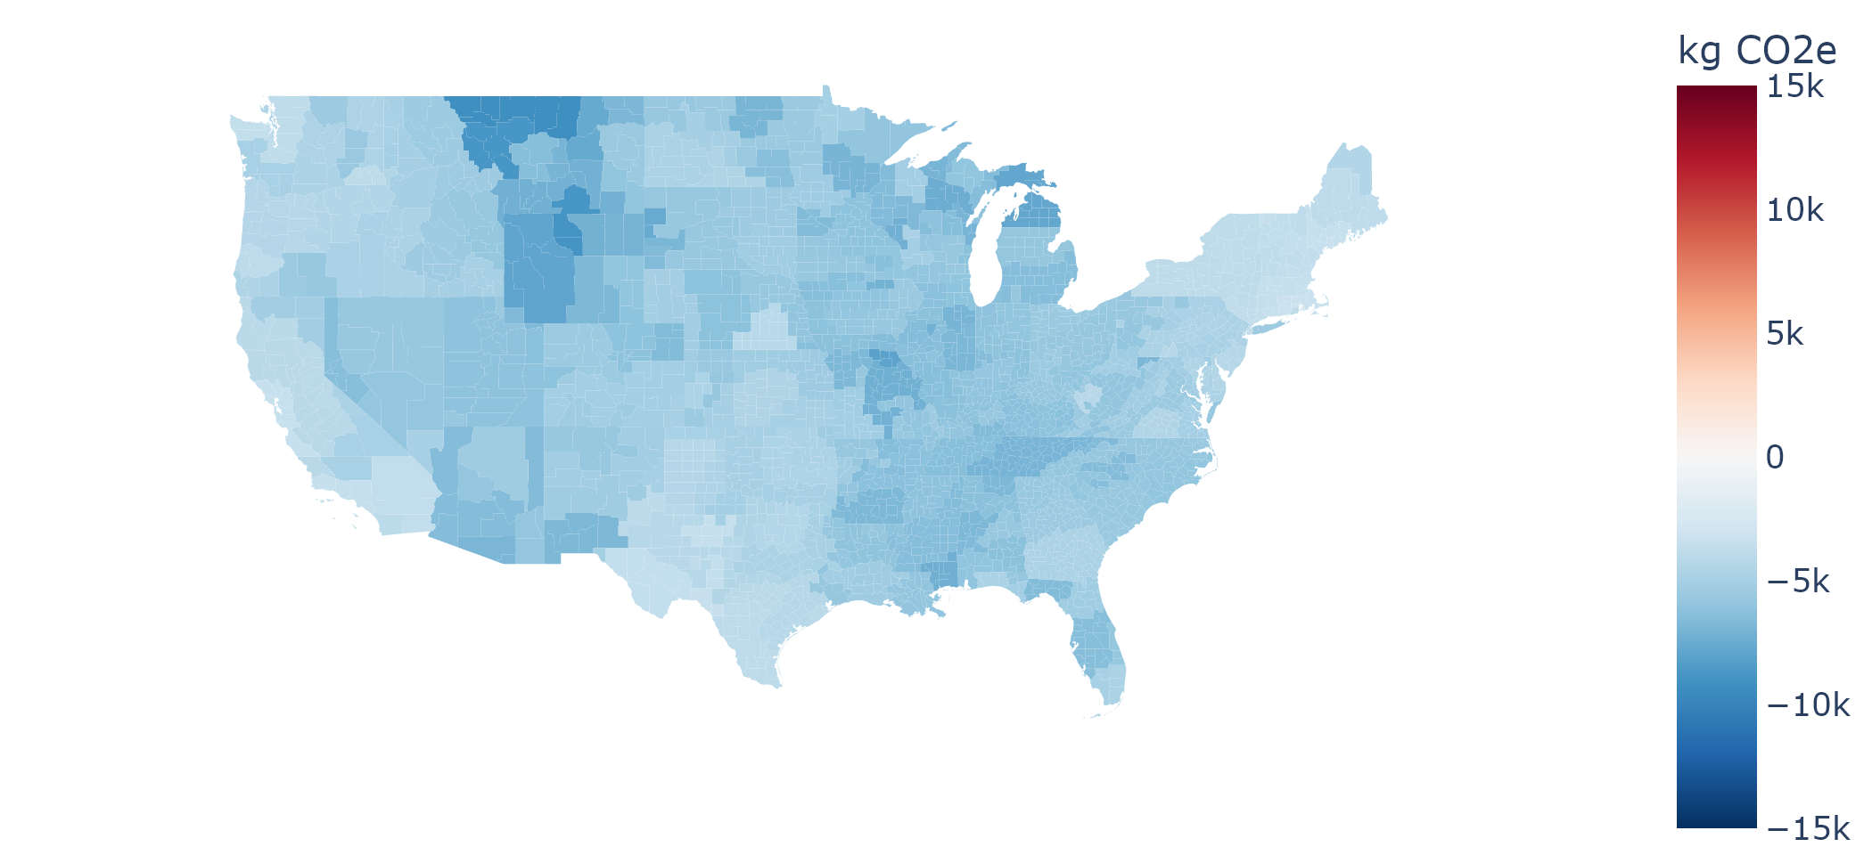
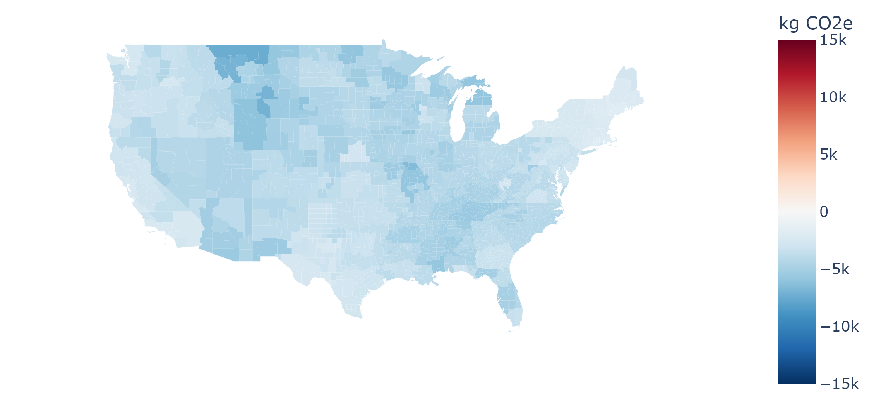



V2H minus
Uncontrolled charging
V2H minus
Controlled charging
Controlled charging minus
Uncontrolled charging
t CO₂e
15
2024
2030
0
2040
-15
130
Lifetime
0
-130

Slide 11






V2H minus
Uncontrolled charging
V2H minus
Controlled charging
Controlled charging minus
Uncontrolled charging

Slide 12






V2H minus
Uncontrolled charging
V2H minus
Controlled charging
Controlled charging minus
Uncontrolled charging

Slide 13
Uncontrolled charging
Controlled charging
V2H
USD
600
2024
2030
0
2040
-600
50k
Lifetime
0
-50k
Figure 1 Median annual charging costs and median lifetime charging costs for individual PEVs, of each region across the US. Charging costs are defined as net increase in electricity bills of the whole home with PEV charging. 2024, 2030 and 2040 are modeled annual results. Results for PEVs with charging modes of uncontrolled charging, controlled charging and V2H are displayed .

